Slide 1
Endocrine Control Systems

Slide 2
Why should a dentist (or a doctoral student) care about endocrinology
Clinical manifestations of endocrine pathophysiology
Diabetes (Insulin Insufficiency/Resistance)
Periodontitis
Mucusal disease
Altered taste
Parotid gland enlargent
Potential hypo/hyperglycemia
Hypoparathyroidism (Not Enough PTH)
Low calcium density, hypoplasia of enamel and dentin
Candidiasis
Delayed eruption, shortened roots
Hyperthyroidism (T3/T4 Overproduction)
Malocclusion
Demineralization
Anxiety/restlessness
Acromegaly (GH Overproduction)
Accelerated tooth eruption
Enlarged jaw, abberant tooth spacing
Cushing’s (Cortisol Overproduction)
Periodontis, swelling of gums
Easy bruising
Addison’s Disease (Cortisol Insufficiency)
Blotchy melanin patches in oral mucosa

Slide 3
Learning Objectives
Define endocrine, paracrine, autocrine, and exocrine systems, define neuro-secretory cells by giving a few examples.
List major chemical categories of hormones and give several examples that belong to each class.
List important factors that determine hormone levels in circulation.
Explain cellular actions of hormones via membrane and nuclear receptors, including an understanding of the rates by which these processes can affect cells.
Define basal secretion and stimulated secretion of endocrine glands.
Describe negative and positive feedback system using an example.
Explain with examples neuroendocrine integration.

Slide 4
Things you (should) already know
Regulation of renal function (Tigyi)
Renin/Angiotensin/Aldosterone/ANF/Vasopressin
Regulation of GI function (Johnson)
Gastrin/CCK/GIP/Secretin/VIP/Motilin
Blood Pressure Regulation (O’Connell)
Angiotensin/Vasporessin/Adrenaline/Noradrenaline/Dopamine/Endothelin
Cardiac Function (Mancarella)
ANP/Adrenaline/Noradrenaline/Acetylcholine
Synaptic Transmission (Adebiyi)
Serotonin/Acetylcholine/GABA/Histamine/Aspartate/Glutamate/NO

Slide 5
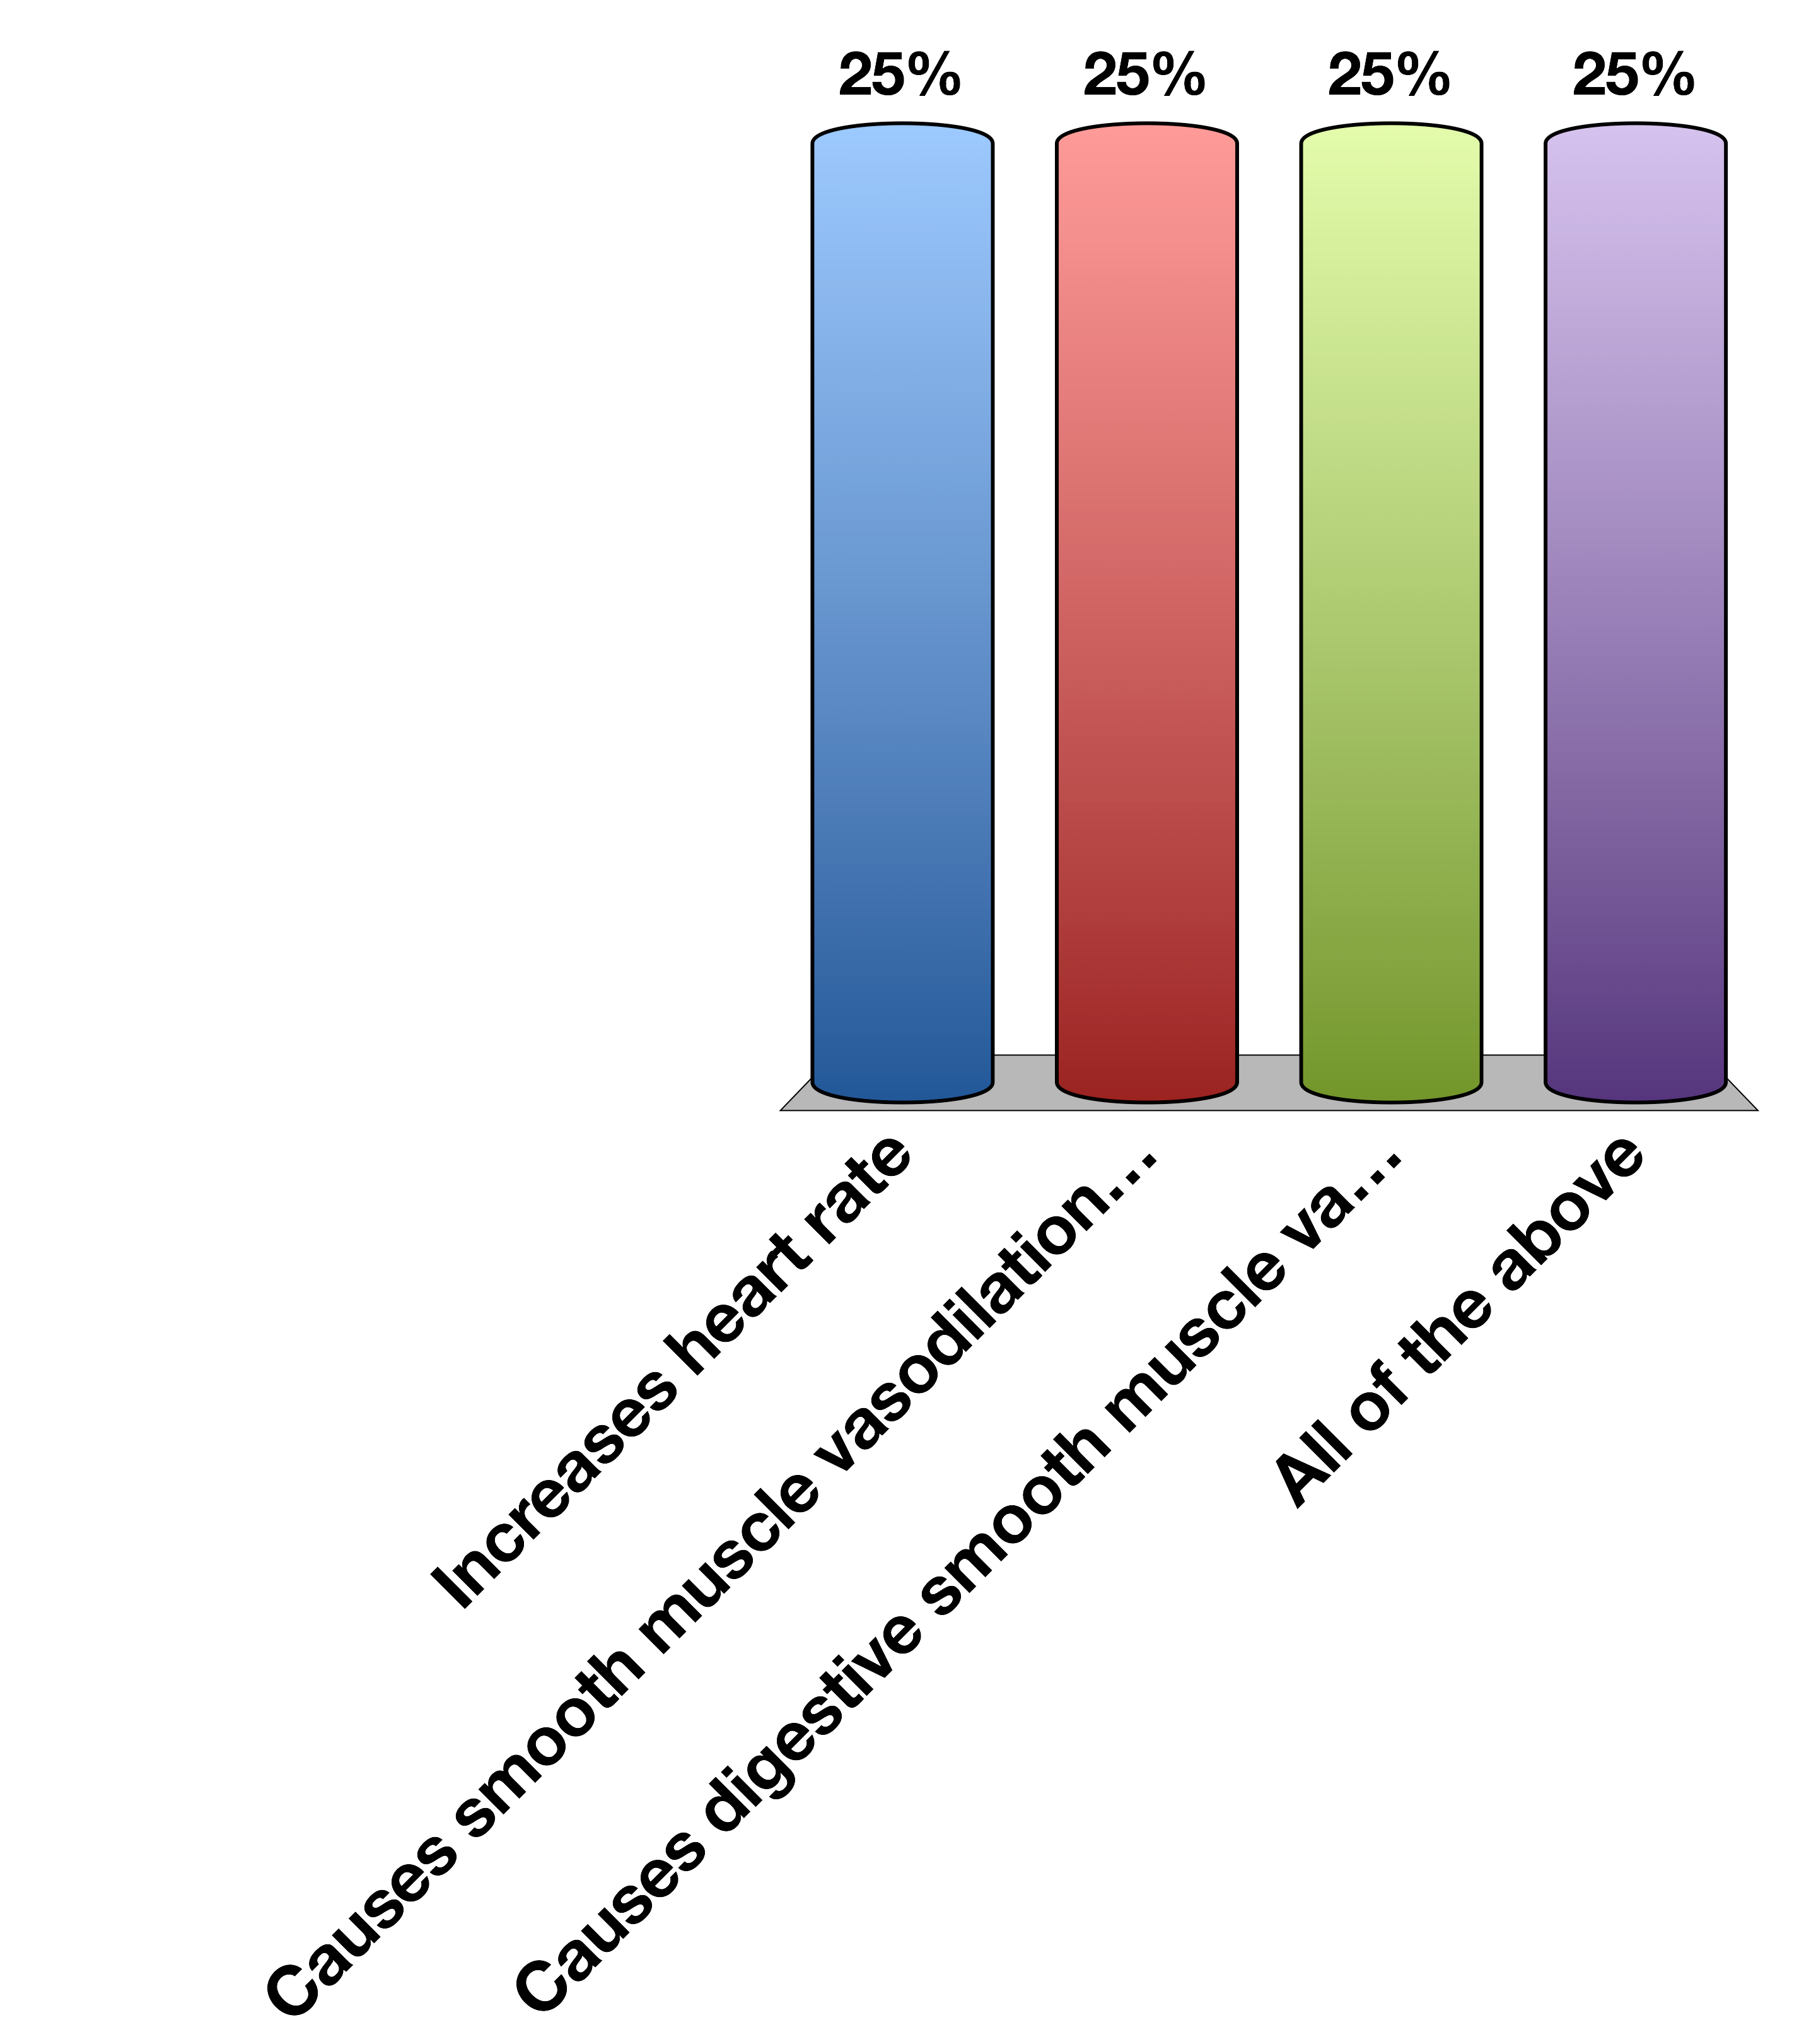
Epinephrine…
Increases heart rate
Causes smooth muscle vasodilation in skeletal muscle
Causes digestive smooth muscle vasoconstriction
All of the above
15

Slide 6
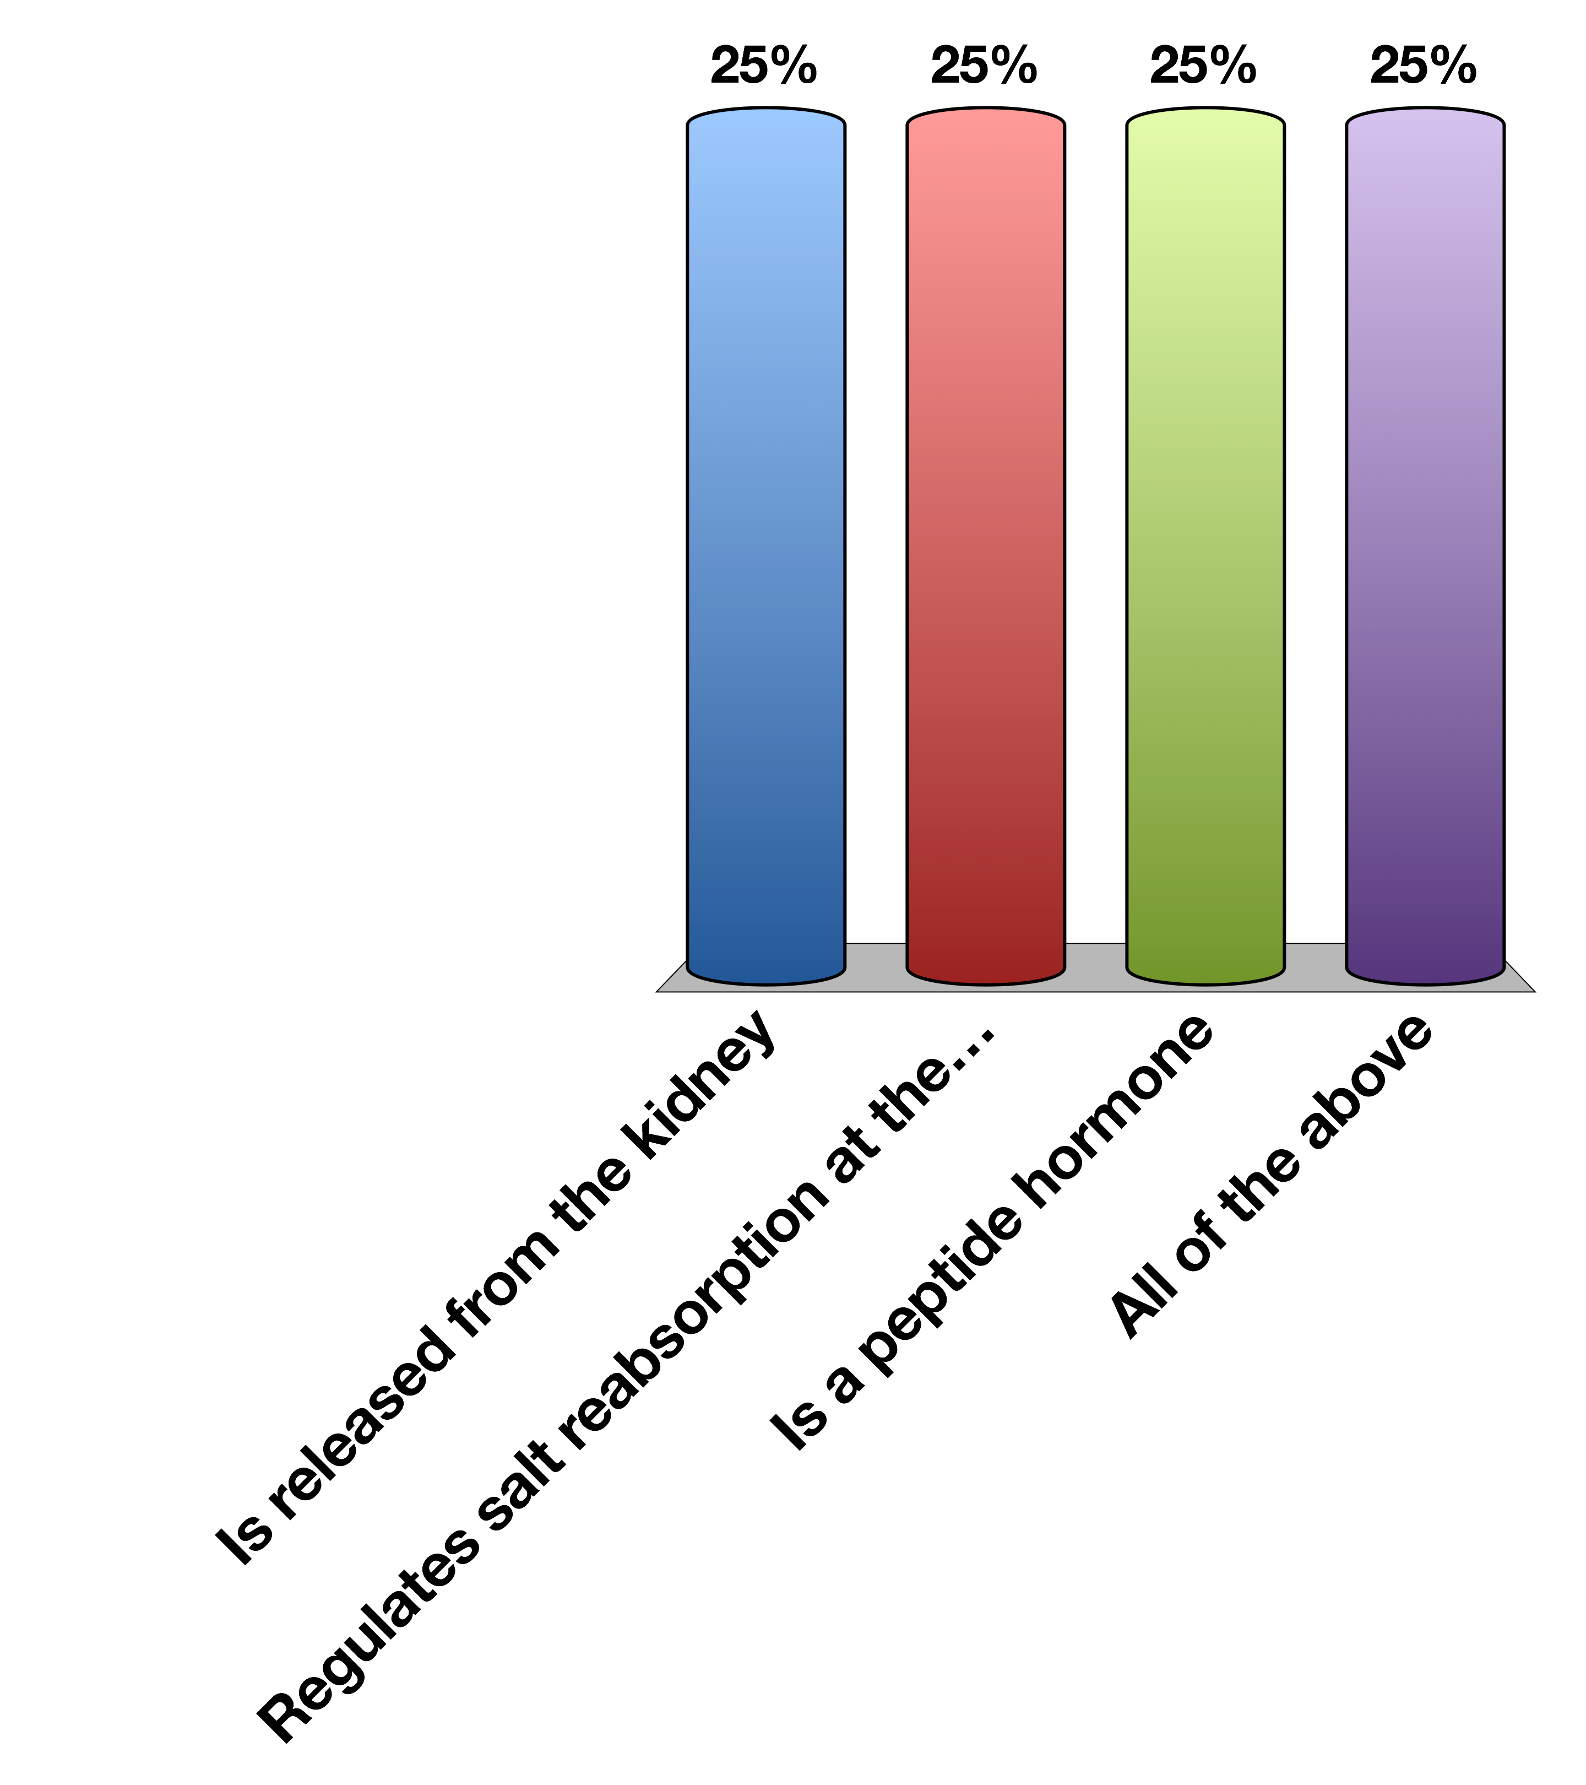
Aldosterone…
Is released from the kidney
Regulates salt reabsorption at the kidney
Is a peptide hormone
All of the above
15

Slide 7
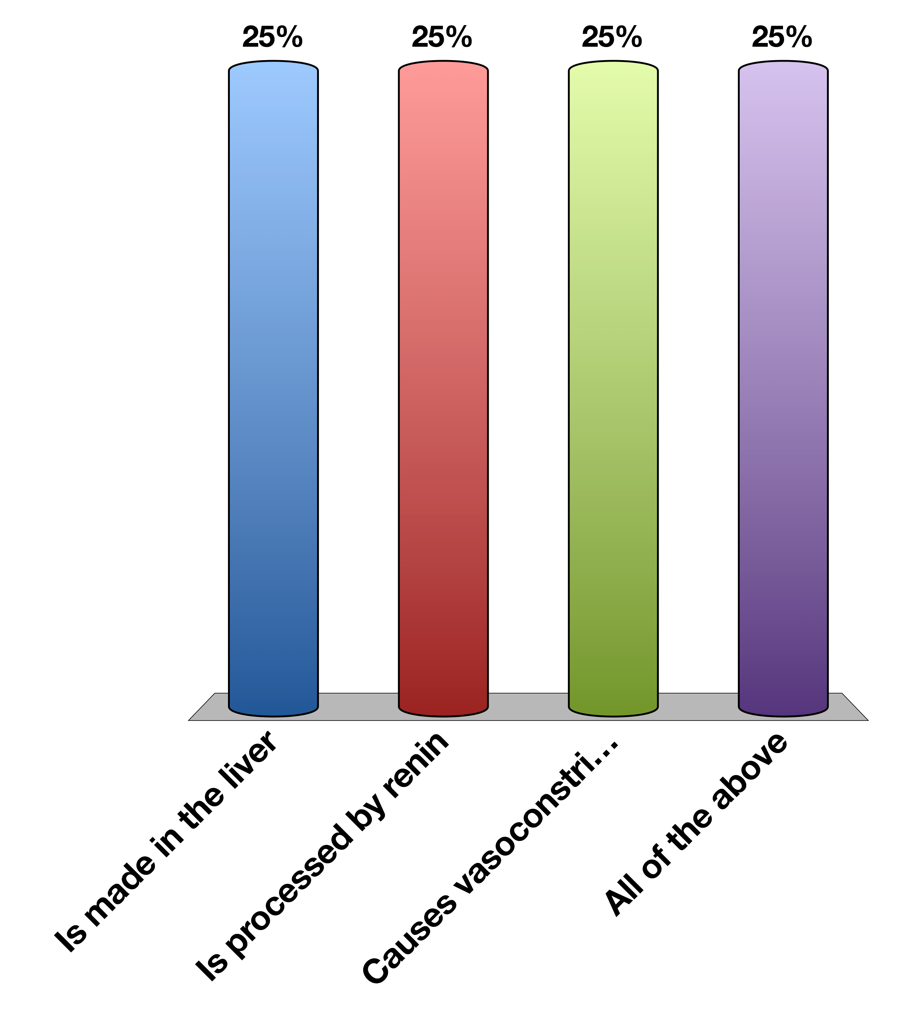
Angiotensin…
Is made in the liver
Is processed by renin
Causes vasoconstriction
All of the above
15

Slide 8
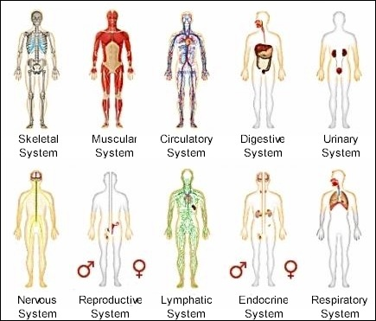
Organ Systems
Notes:
Most organ systems you are learning about in this series are physically connected organelles. These organelles evolved to have extremely important specialized functions, but in physiology these systems must be able to communicate with each other and the outside world

Slide 9
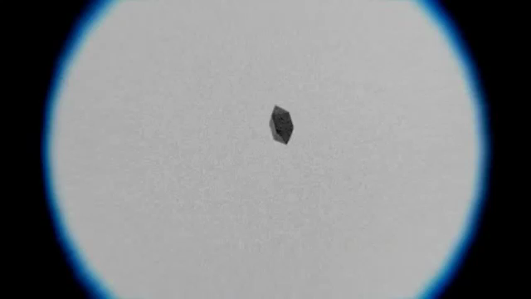
Extracellular Sensing
https://www.youtube.com/watch?v=F6QMU3KD7zw
Notes:
Bacteria chemotaxis around a sugar cube

Slide 10
What are the important processes?
There has to be a signal
That signal has to be detected
The cell has to respond to that signal
After a while the signal has to be stopped

Slide 11
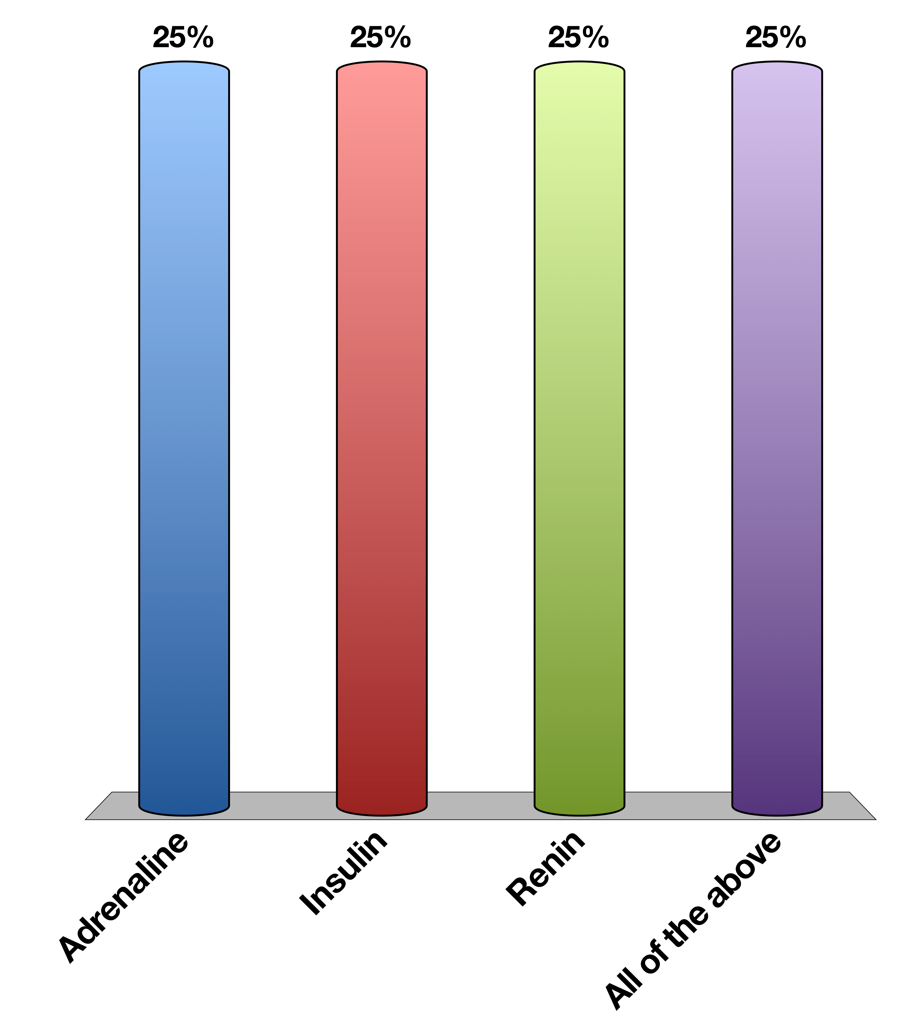
When fight or flight increases blood flow to muscles, what is the signal
Adrenaline
Insulin
Renin
All of the above
15

Slide 12

What cells respond to that signal
Cardiac muscle
Skeletal muscle
Vascular smooth muscle
All of the above
15

Slide 13
What do we need to know about a hormone?
What kind of chemical is it?
Where is it made?
What causes its release?
What are its receptors?
What tissues does it effect?
How does it get turned off

Slide 14
Example Adrenaline
What kind of chemical is it? | Biogenic Amine | Tyrosine Derivative
Where is it made? | Adrenal medulla
What causes its release? | Sympathetic nervous stimulation
What is its receptor? | Alpha/Beta-Adrenergic Receptors | GPCR -> Gs and Gi
What tissues does it affect? | Heart | Increased heart rate
 | Lungs | Increased respiration
 | Vasculature | Vasoconstriction (smooth muscle), vasodilation (skeletal muscle)
 | Liver | Glycogenolysis
 | Fat | Lipolysis
 | Skeletal Muscle | Contraction
How does it get turned off? | Sympathetic signal stops

Slide 15
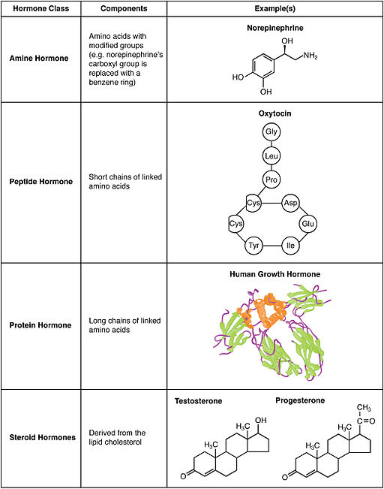
What Kinds of Hormones Are There?
Notes:
Note size of human growth hormone

Slide 16
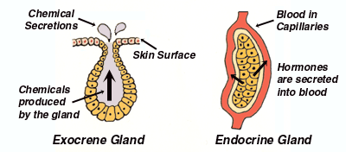
Endocrine vs Exocrine

Slide 17
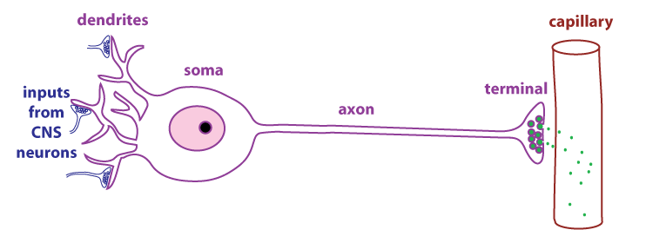
Neuroendocrine Secretions

Slide 18
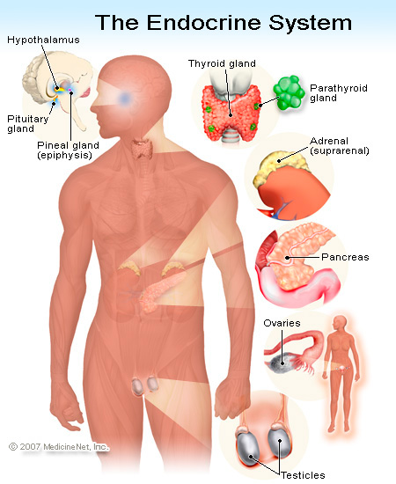
Generally, where are hormones made
Notes:
Total oversimplification as hormones are now known to be made in many other tissues (gut/fat/muscle).
Point out that the same gland often makes hormones of the same chemical class, even though they exert different effects

Slide 19
Generally how are hormones released?
Nervous stimulation
Adrenaline, CRH, TSH
In Response to Another Hormone
Cortisol (ACTH), Thyroid Hormones (TSH)
In Response to A Metabolite
Insulin, Glucagon, Calcitonin
In Response to Physical Changes Such As Stretch
Ghrelin, Renin
Notes:
Calcitonin responds to elevated calcium

Slide 20
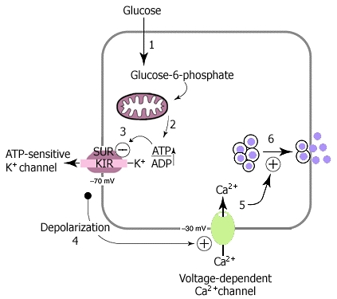
Insulin Release In Response To Glucose

Slide 21
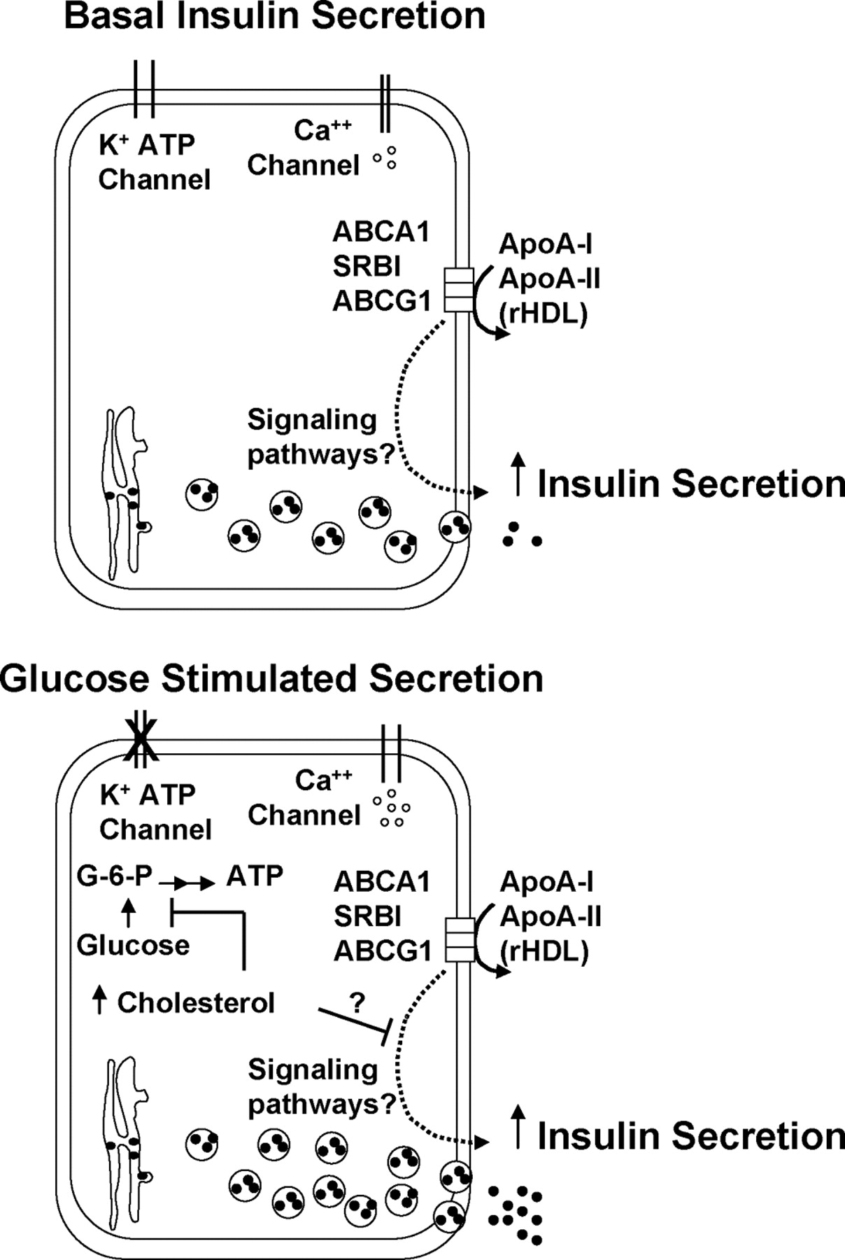
Basal vs Stimulated Secretion

Slide 22
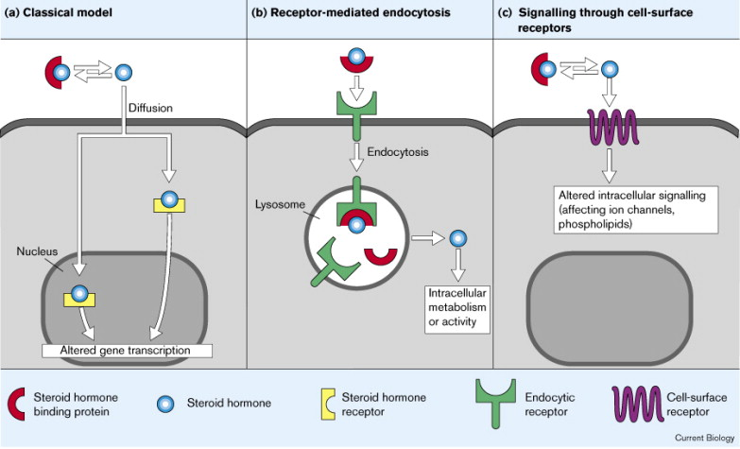
What Kinds of Receptors Are There?
Notes:
If I tell you the chemical type of the hormone, you should be able to tell me whether it is a nuclear hormone or a cell surface receptor

Slide 23
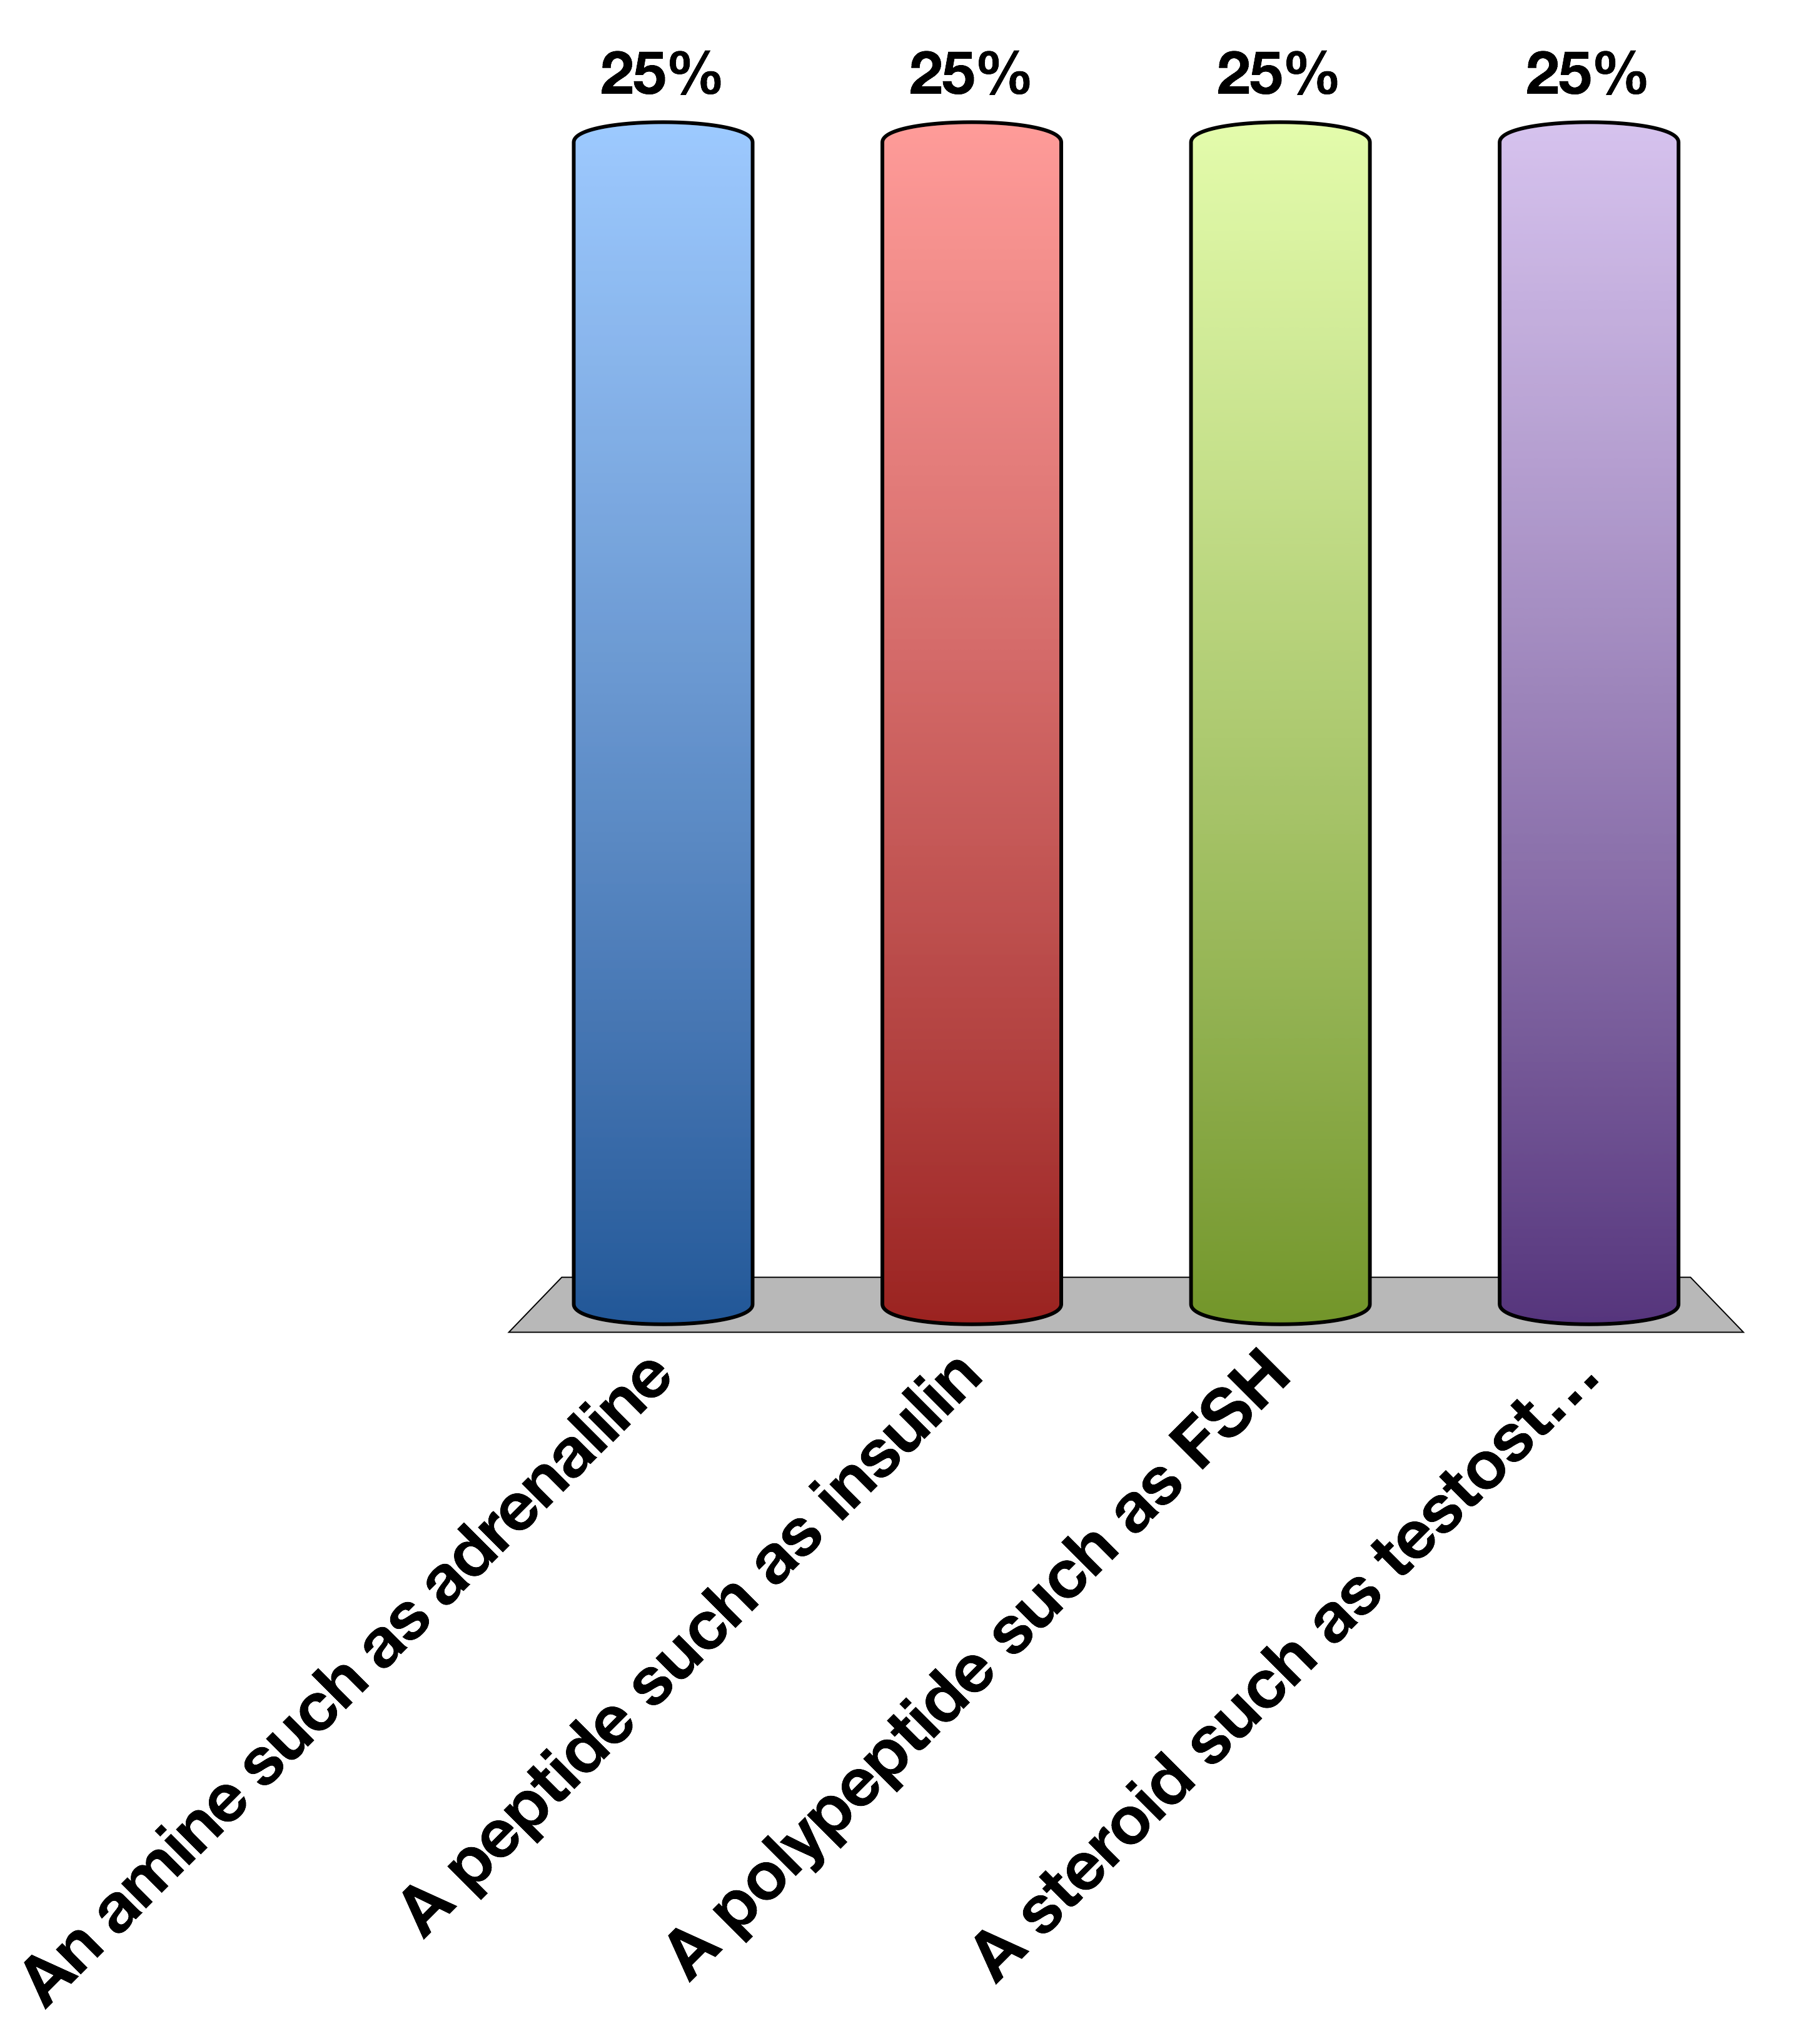
Which hormone type is most likely to be able to cross plasma membranes
An amine such as adrenaline
A peptide such as insulin
A polypeptide such as FSH
A steroid such as testosterone
15

Slide 24
Which hormone type is most likely to be able to cross plasma membranes
An amine such as adrenaline
A peptide such as insulin
A polypeptide such as FSH
A steroid such as testosterone
15

Slide 25
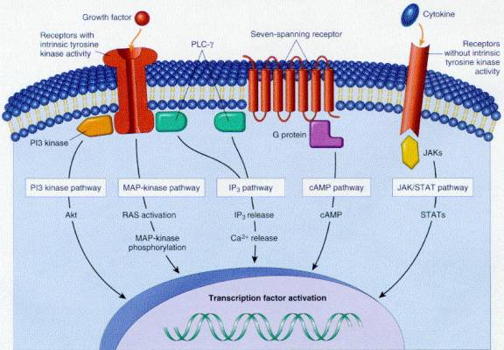
Cell Surface Receptors

Slide 26
Types of Cell Surface Receptors
GPCRs
Receptor Tyrosine Kinases
JAK/STAT Receptors
7-TM
Activates G proteins in several classes
Can regulated cAMP, Ca, DAG and RhoGTPases
Example β−AR
1-TM (dimer)
Autophosphorylate on tyrosine residues
Recruits and activates effectors like Akt
Example InsR
1-TM (dimer)
Recruits kinase (JAK) which phosphorylates effectors (STAT)
pSTAT activates gene transcription
Example GH

Slide 27
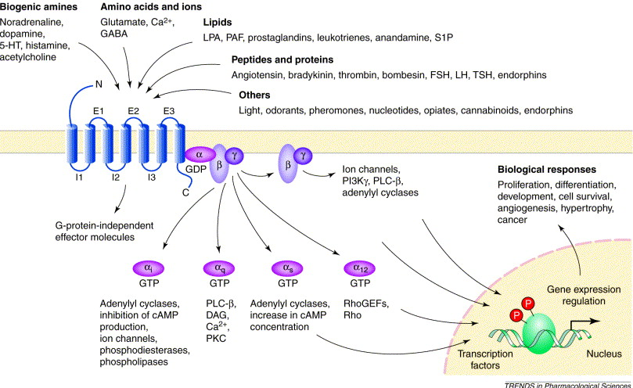
GPCRs

Slide 28
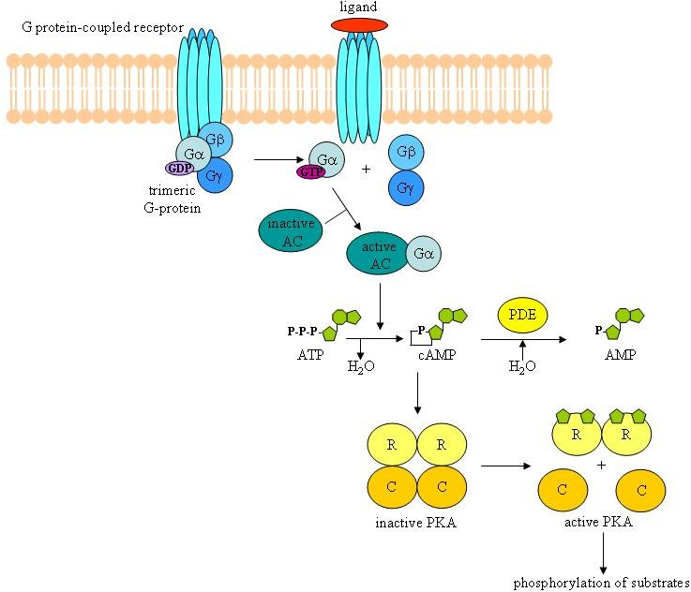
GPCRs and PKA

Slide 29

Somatostatin is a Gi-linked GPCR
Somatostatin activates PKA
Somatostatin decreases cAMP
Somatostatin receptor is a nuclear hormone receptor
All of the above

Slide 30
Somatostatin is a Gi-linked GPCR
Somatostatin activates PKA
Somatostatin decreases cAMP
Somatostatin receptor is a nuclear hormone receptor
All of the above

Slide 31
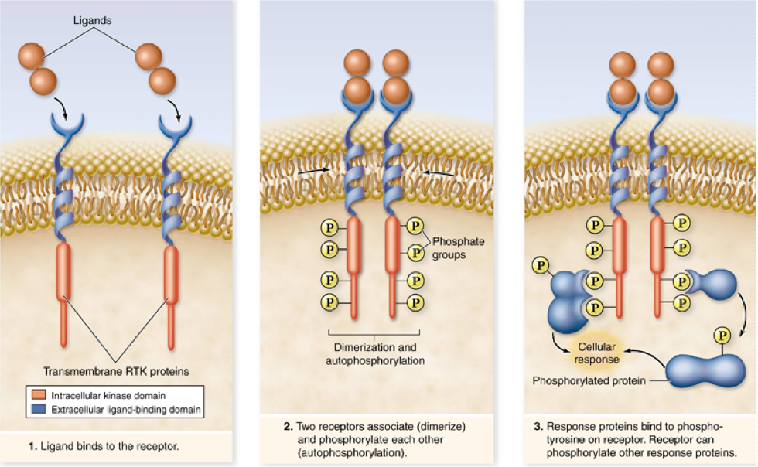
Receptor Tyrosine Kinases

Slide 32
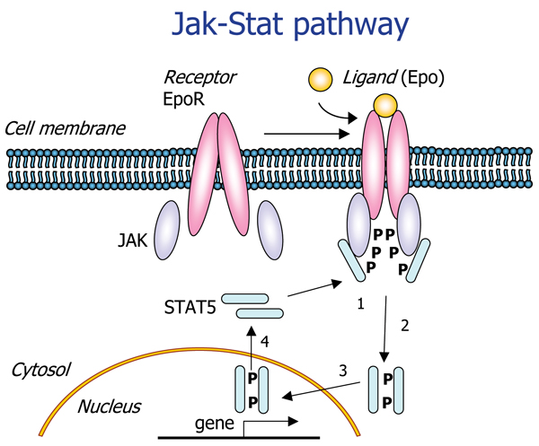
JAK/STAT Receptors

Slide 33
Nuclear Hormone Receptors

Slide 34
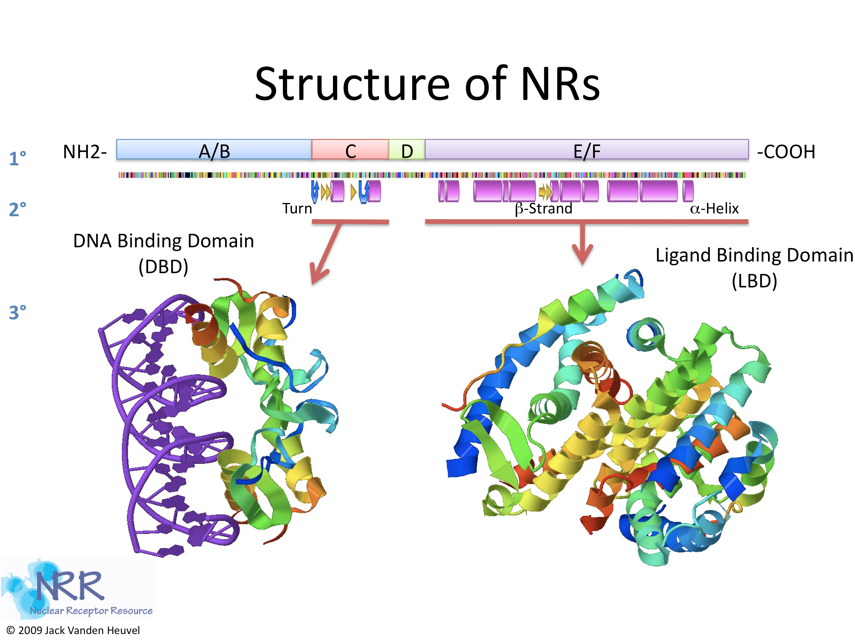
What Do Nuclear Hormones Look Like?

Slide 35

Which hormonal responses will occur fastest?
GH effects on new mRNA/protein (JAK/STAT)
Insulin effects on enzyme activity (RTK)
Testosterone effects on mRNA/protein (NHR)
They all occur at the same speed
15

Slide 36
General Concepts About Hormone Targets
How does the hormone get from A -> B
Is it released into the blood?
Does it require accessory proteins to help keep it soluble?

Slide 37
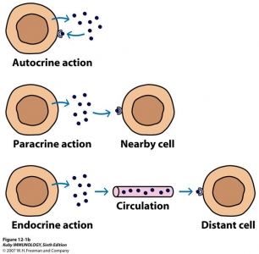
Relative Location of Action

Slide 38
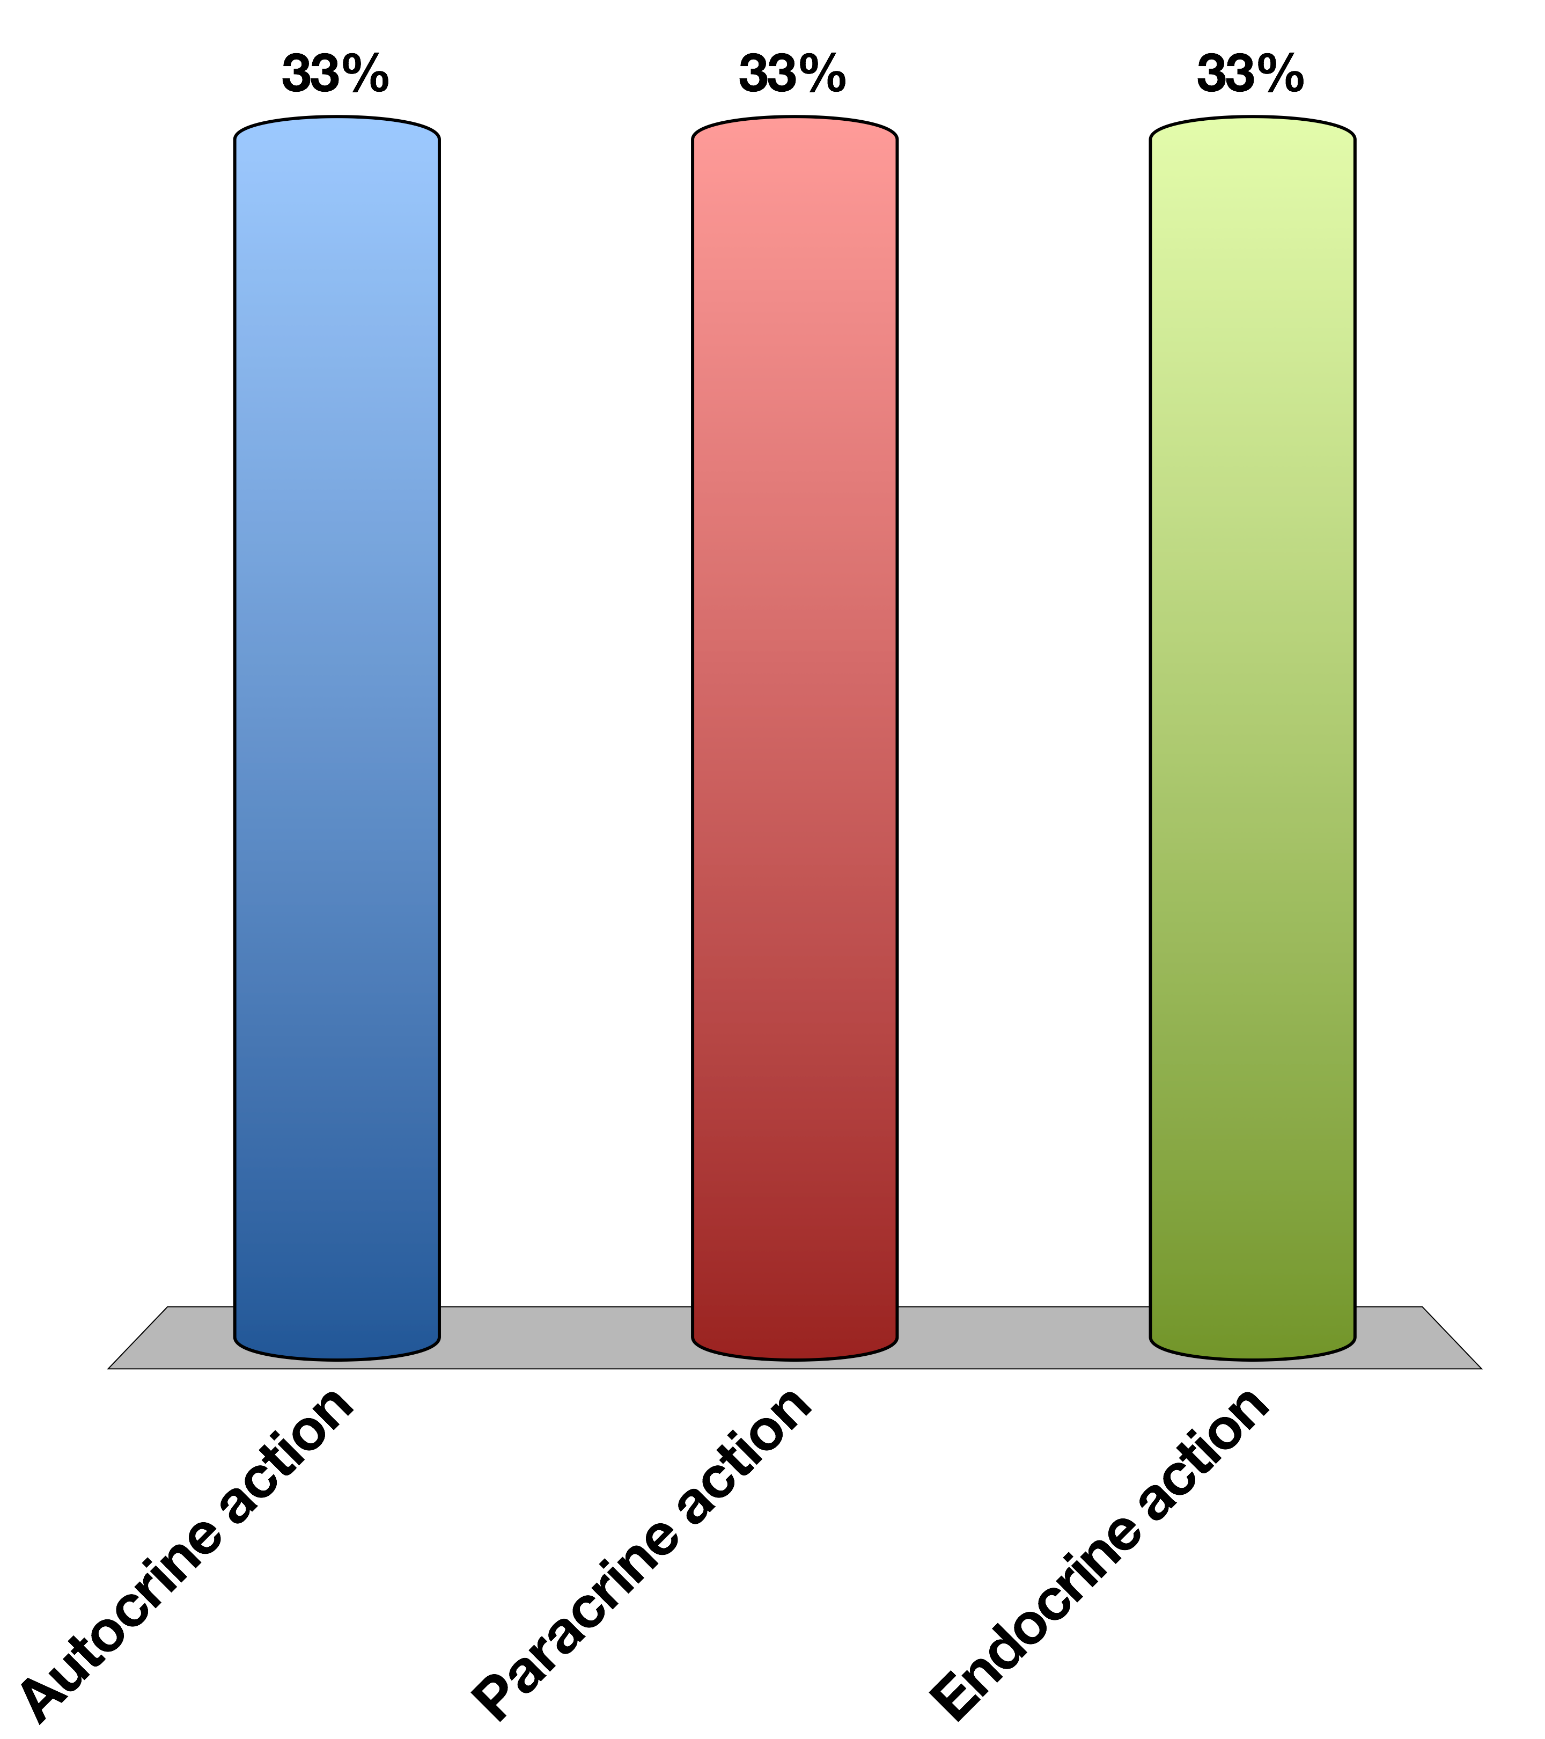
Insulin is released from pancreatic beta cells and is sensed by pancreatic alpha cells to reduce glucagon secretion. This is an example of …
Autocrine action
Paracrine action
Endocrine action
15

Slide 39
Insulin is released from pancreatic beta cells and is sensed by pancreatic alpha cells to reduce glucagon secretion. This is an example of …
Autocrine action
Paracrine action
Endocrine action
15

Slide 40
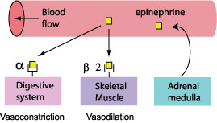
How To Get Hormonal Specificity?
Restrict the location of the hormone release (ie neurotransmitters only released into synapse)
Restrict the receptors to particular tissues
Have the receptors mediate different processes in different cell types
For more details see O’Connell’s lectures on blood pressure regulation

Slide 41
Turning the Signal off
Induce hormone resistance at the target cell
Prevent further hormone production and/or reduce the levels

Slide 42
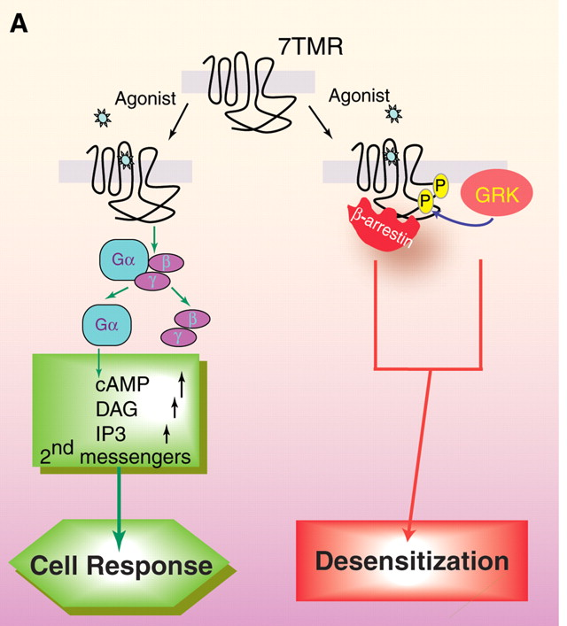
Example: Arrestins and GPCRs
Lefkowitz RJ, Shenoy SK (2005) Transduction of receptor signals by beta-arrestins. Science 308: 512–517. doi:10.1126/science.1109237.

Slide 43
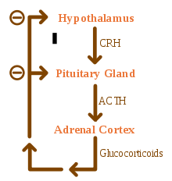
Example: Reduce New Hormone Secretion
Notes:
Point out that this is an example of neuroendocrine regulation

Slide 44
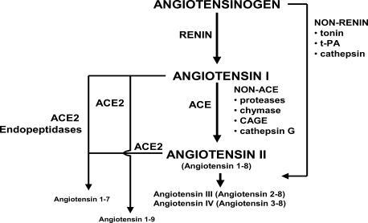
Example: Degrade Existing Hormones

Slide 45
Group Project
Pick some hormone that you think you know of its function
Imagine a patient that has no negative feedback to that hormone. What happens and why?
Now imagine another patient that has way too much negative feedback to that hormone. What happens and why?

Slide 46
Integration of the CNS with Endocrine Signals
In Response To CNS
To Modify CNS
Externally sensed cues (ie, look a bear!)
Release of adrenaline
Modify peripheral responses
Internally sensed cues (ie, my stomach is full)
Feeding hormones (Leptin, Ghrelin, PYY)
Modify behavior

Slide 47
Learning Objectives
Define endocrine, paracrine, autocrine, and exocrine systems, define neuro-secretory cells by giving a few examples.
List major chemical categories of hormones and give several examples that belong to each class.
List important factors that determine hormone levels in circulation.
Explain cellular actions of hormones via membrane and nuclear receptors, including an understanding of the rates by which these processes can affect cells.
Define basal secretion and stimulated secretion of endocrine glands.
Describe negative and positive feedback system using an example.
Explain with examples neuroendocrine integration.

Slide 48
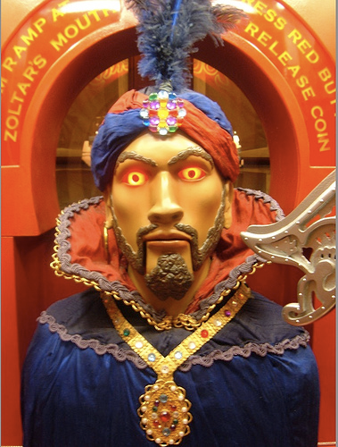
Your Future
Endocrine Control Systems
Neuroendocrinology and the Posterior Pituitary
Endocrine Control of Growth
Adrenals and Stress Hormones
Hypothalamus and Endocrine Control of Appetite
Pancreatic Hormones and Metabolic Control
Thyroid Hormones (KP)
Calcium Homeostasis (MF)
Reproductive Hormones (HP)

Slide 49
Design a hormone
What process does it govern?
What signals its release? Does it result from external cues, or internal cues?
Under what time-scale does this change occur?
What should end the signaling event?
What would be the pathophysiology of this hormone not existing? How about being far too active?

Slide 50

What is the most likely receptor?
Cell surface because changes are fast
Nuclear hormone because transcriptional changes are fast
Cell surface because changes are slow
Nuclear because transcriptional changes are slow
15

Slide 51
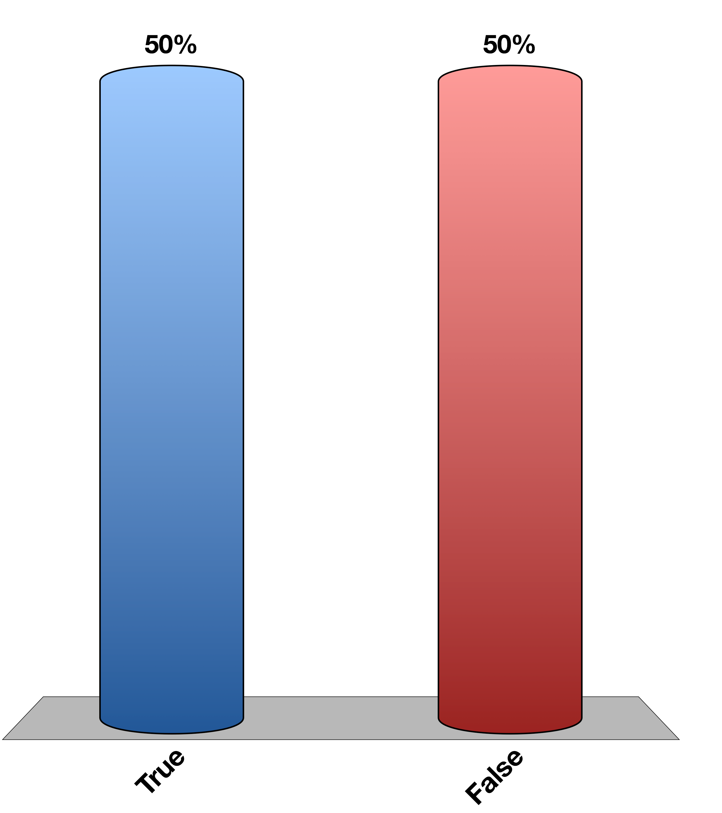
Is this a neurendocrine hormone
True
False
15

Slide 52
Neuroendocrinology and the Posterior Pituitary

Slide 53
Learning Objectives
Recall anatomical, biochemical, and functional evidence showing intimate relationships between hypothalamus and pituitary.
Describe how hormones are sensed by the neurons of the hypothalamus, and the role that the blood brain barrier and transport mechanisms play.
Recall how the central nervous system can integrate with the hypothalamus and modify both hormonal secretions and executive function.
Describe the differences in how hypothalamic signals are passed to the posterior and anterior pituitary glands.
List the known hypothalamic hormones which cause release (and release-inhibition) of anterior pituitary hormones, including their acronymns.
Name two major posterior pituitary hormones, their chemical category, and succinctly describe their secretory mechanism.
Describe cellular actions of vasopressin in terms of site of actions, receptors, and cellular signals.
Discuss briefly aquaporin water channels and relation to vasopressin.
Predict what the changes are expected in urine volume and osmolality and in ECF volume when vasopressin synthesis or secretion is severely impaired. Predict what will happen to water intake. Explain why there can be transient diabetes insipidus following a whiplash injury, and the rationale for therapy during this time.
Describe the control of vasopressin release.
Describe the function of oxytocin with respect to delivery and lactation.

Slide 54
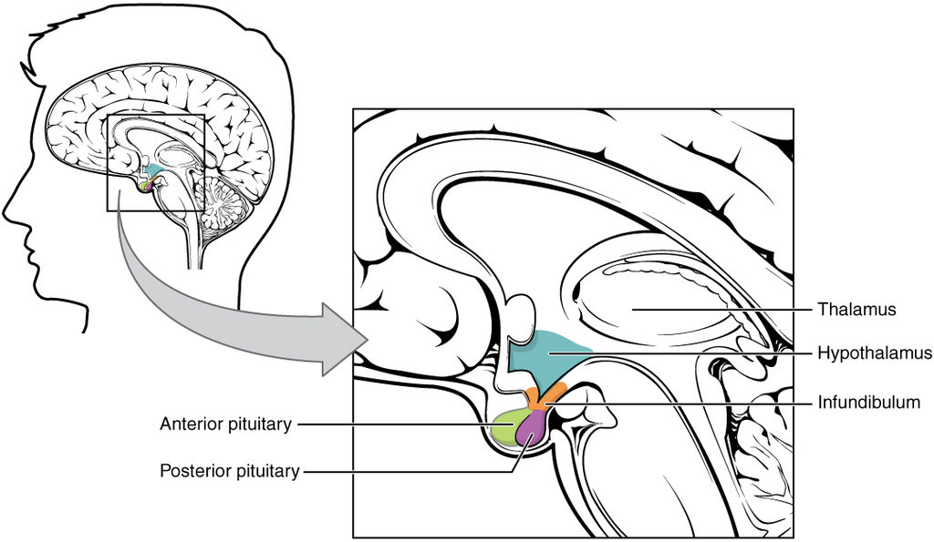
The Hypothalamus Is the Main Site of Endocrine/CNS Integration

Slide 55
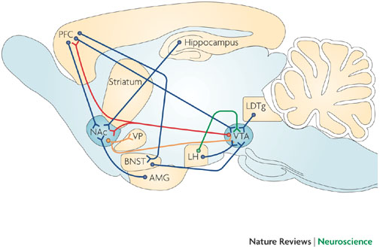
The Hypothalamus Projects to and From Other Brain Regions
Kauer JA, Malenka RC (2007) Synaptic plasticity and addiction. Nat Rev Neurosci 8: 844–858. doi:10.1038/nrn2234.
Notes:
LH is lateral hypothalamus
VTA is in midbrain
AMG is amygdala
PFC is prefromtal cortex

Slide 56
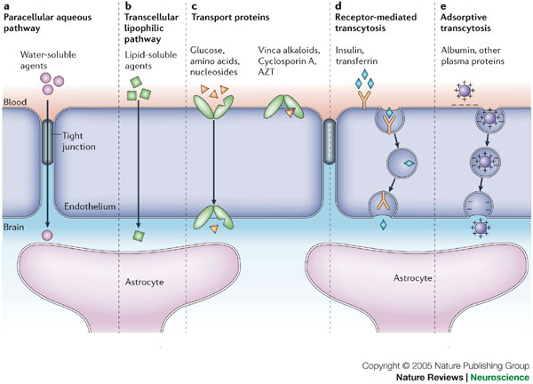
How Are Hormones Sensed by the Hypothalamus?

Slide 57
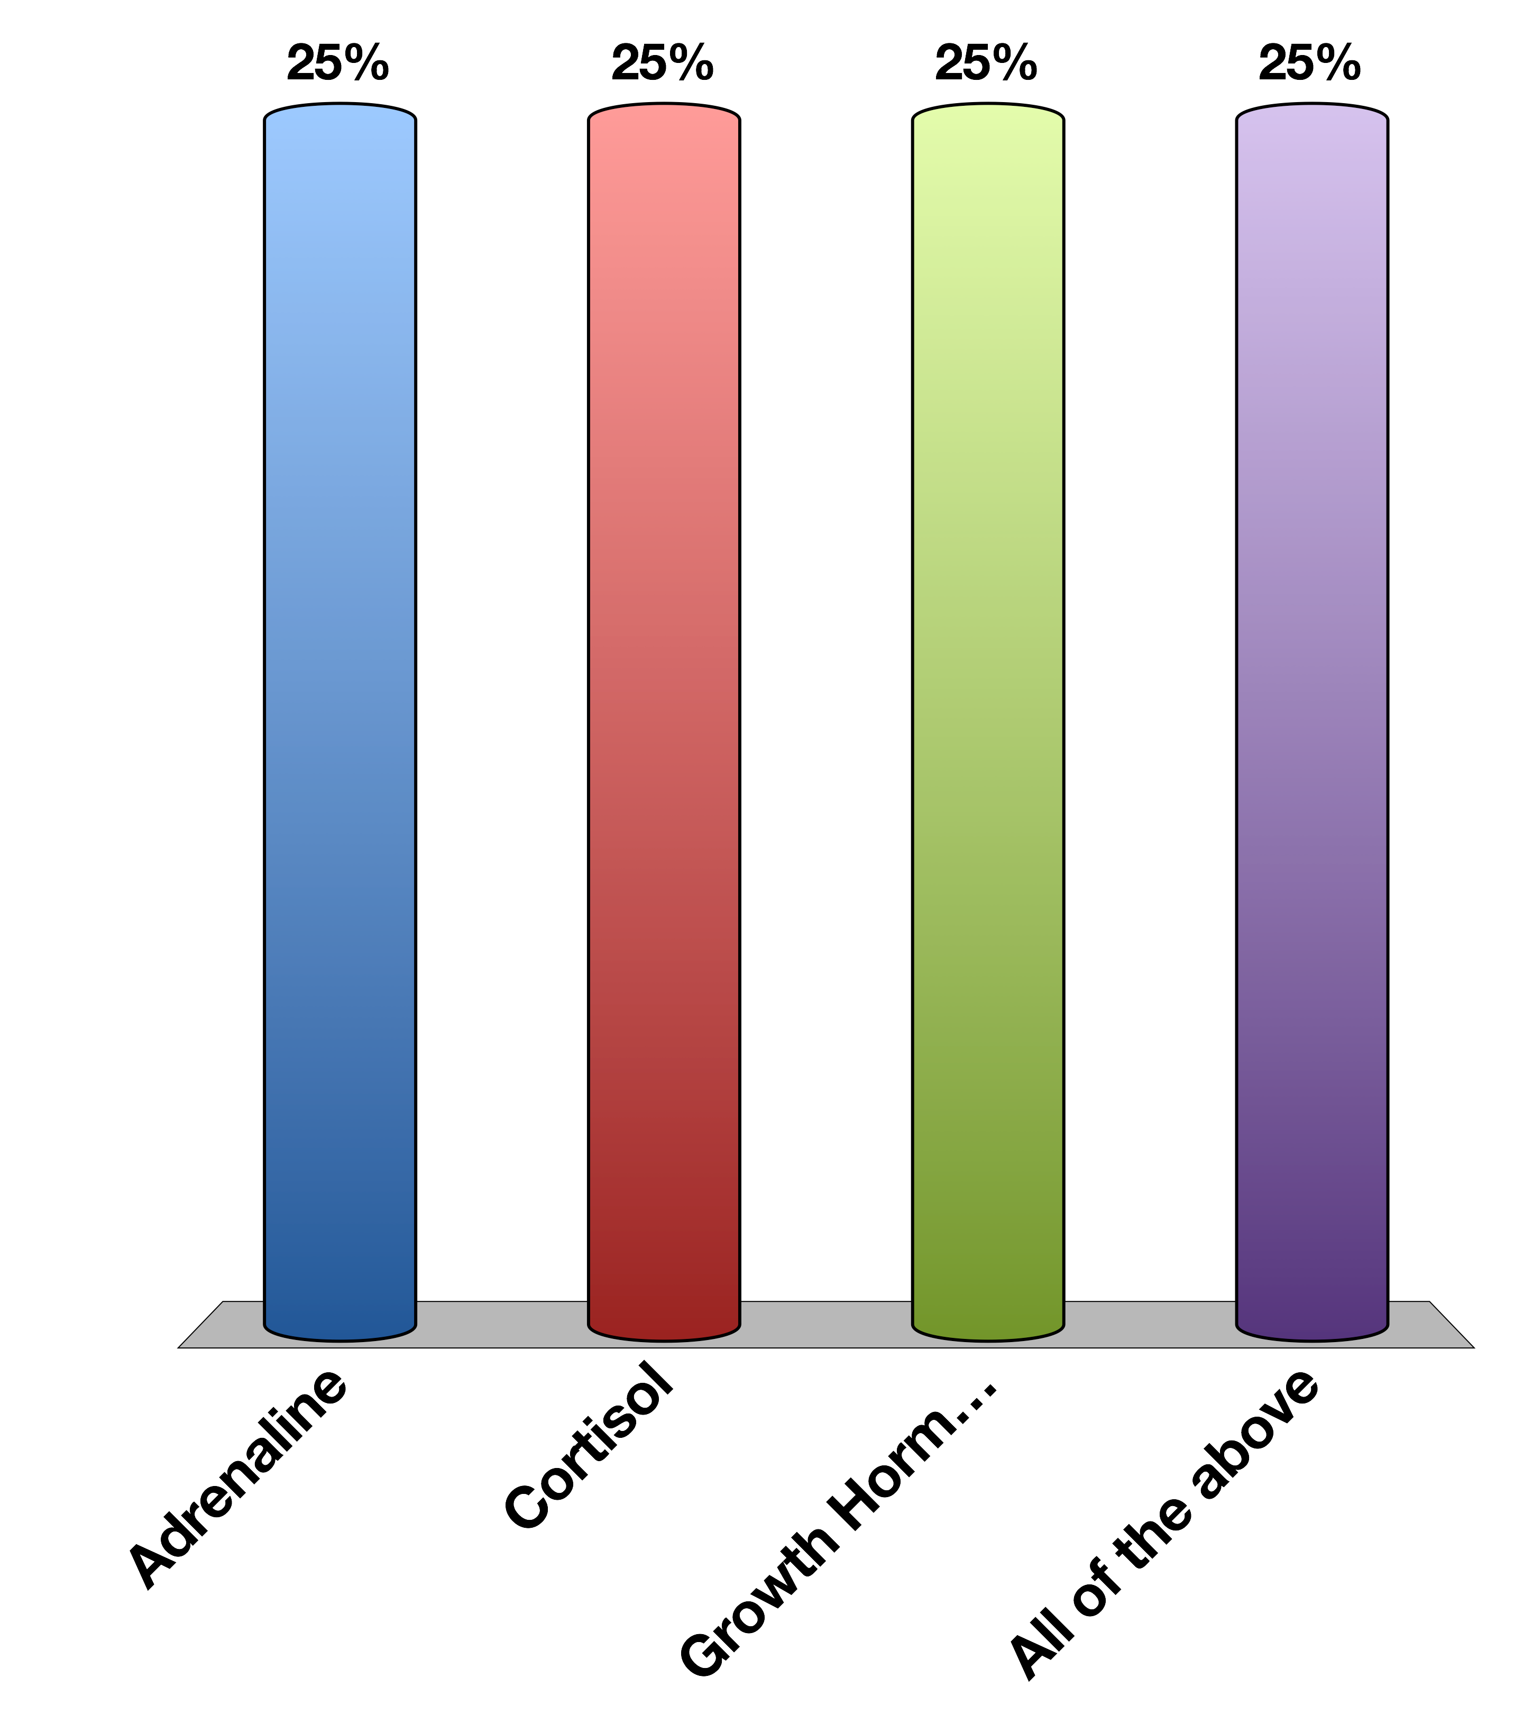
Which hormone is unlikely to be BBB-permeable without transport
Adrenaline
Cortisol
Growth Hormone
All of the above
15

Slide 58
Which hormone is unlikely to be BBB-permeable without transport
Adrenaline
Cortisol
Growth Hormone
All of the above
15

Slide 59
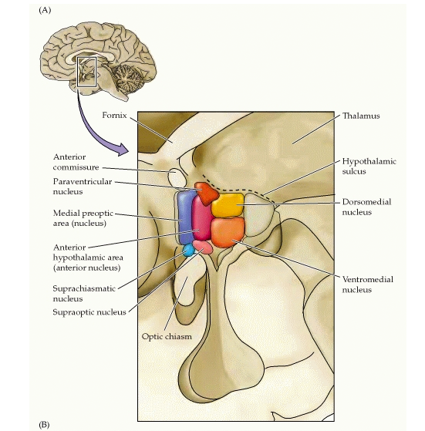
Subregions of the Hypothalamus
Notes:
Each of these regulates different processes
Mention how there is no way for endocrine secretion within the hypothalamus

Slide 60
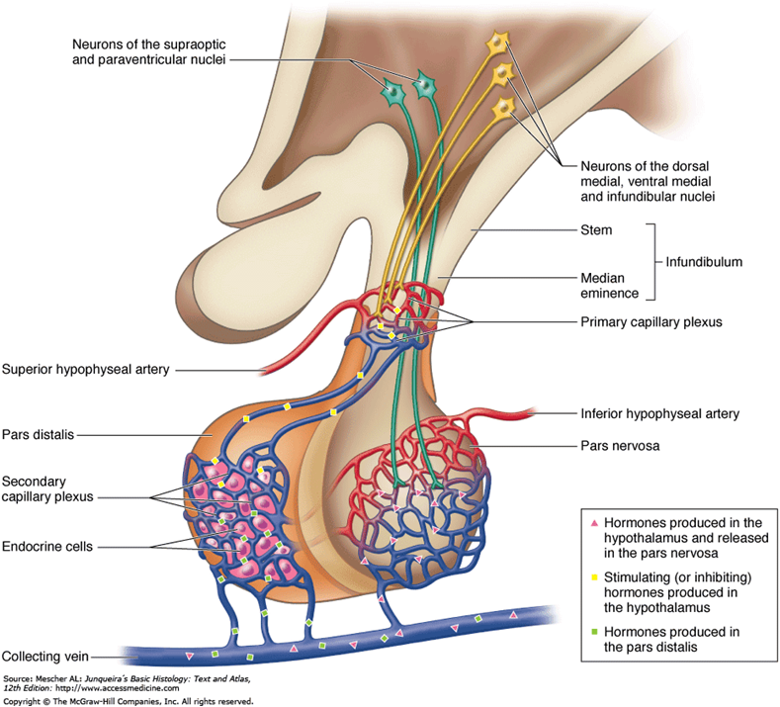
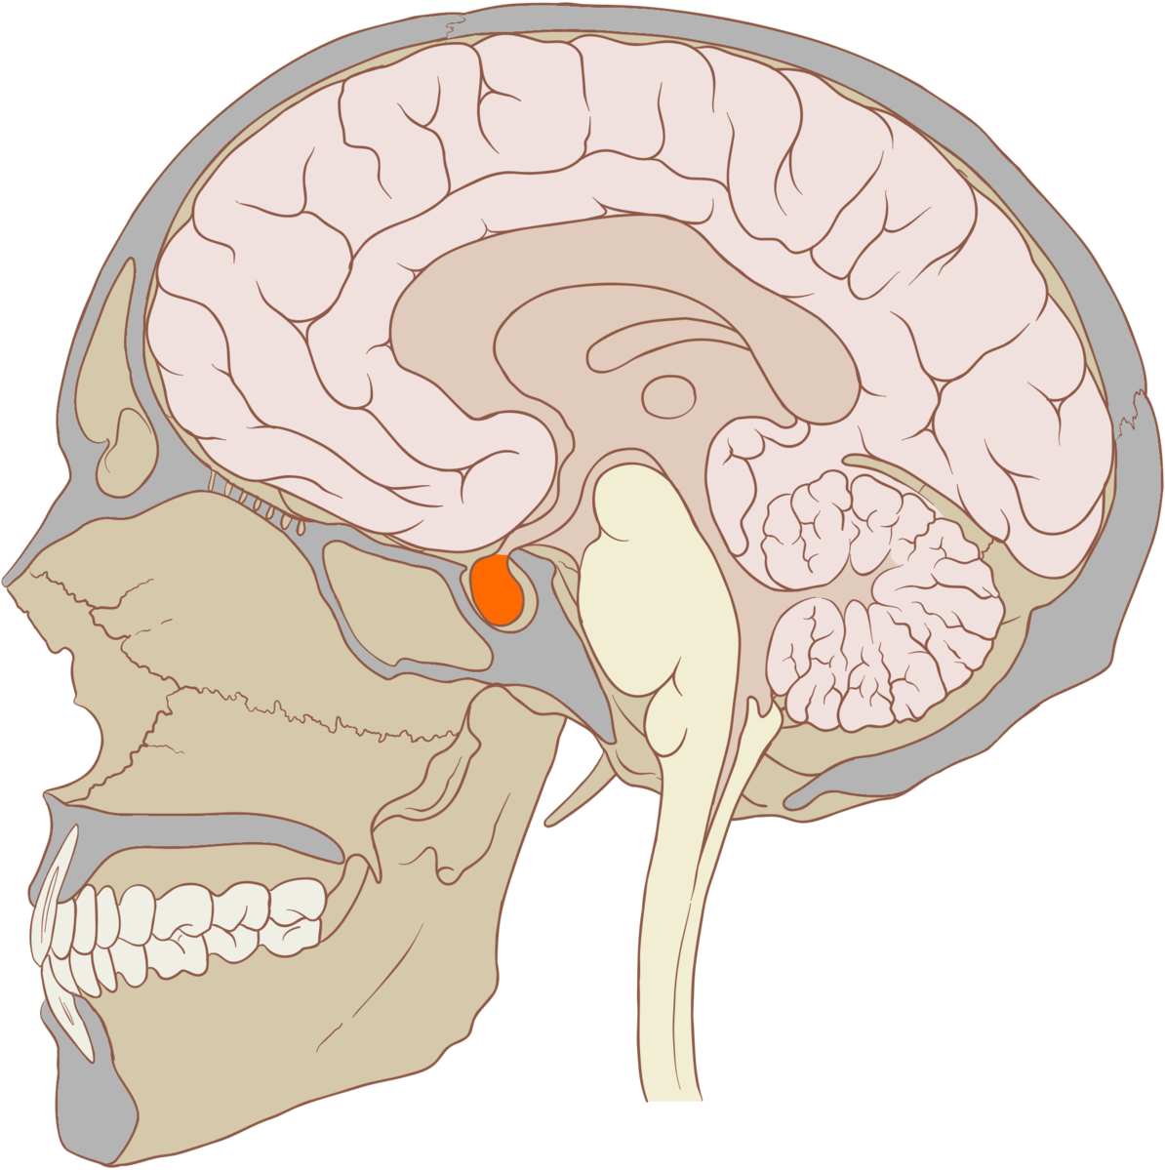
Anatomy of the Pituitary
Neurohypophysial
Portal System
Posterior
Pituitary
Anterior
Pituitary
Notes:
Anterior pituitary is connected to the hypothalamus by capilaries called the hypophyseal portal system
Posterior pituitary is connected to the hypothalamus by neurons
Both can secrete hormones directly into the circulation

Slide 61
The posterior pituitary is connected to the hypothalamus by neuronal contacts
True
False
15

Slide 62

The hypothalamus wants to tell the anterior pituitary to secrete ACTH. How would this be done
Hypothalamic neurons have synaptic contacts with ACTH releasing cells
Hypothalamic neurons release a ACTH-releasing hormone
Neither A nor B
Both A + B
15

Slide 63
The hypothalamus wants to tell the anterior pituitary to secrete ACTH. How would this be done
Hypothalamic neurons have synaptic contacts with ACTH releasing cells
Hypothalamic neurons release a ACTH-releasing hormone
Neither A nor B
Both A + B
15

Slide 64
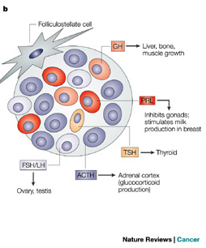
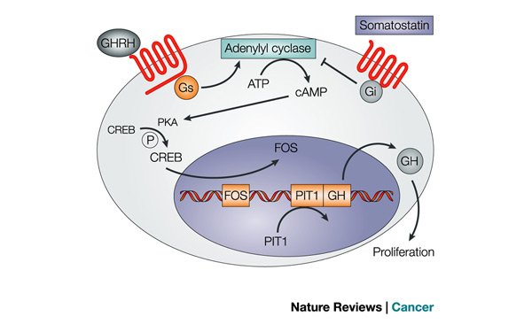
Anterior Pituitary
Hypothalamic | Anterior Pituitary | Cells
CRH | ACTH | Corticotropes
TRH | TSH/Prolactin | Thyrotropes/ Lactotropes
GnRH | LH/FSH | Gonadotropes
GHRH | GH (increase) | Somatotropes
Somatostatin | GH (decrease) | Somatotropes
Asa SL, Ezzat S (2009) The pathogenesis of pituitary tumors. Annu Rev Pathol 4: 97–126. doi:10.1146/annurev.pathol.4.110807.092259.
Notes:
Mention all GPCRs

Slide 65

How Is Specificity Achieved in Hypothalamlic-Anterior Pituitary Signaling
Specialized target cells
Specific and direct neuronal connections
Different signaling cascades
All of the above

Slide 66
How Is Specificity Achieved in Hypothalamlic-Anterior Pituitary Signaling
Specialized target cells
Specific and direct neuronal connections
Different signaling cascades
All of the above

Slide 67
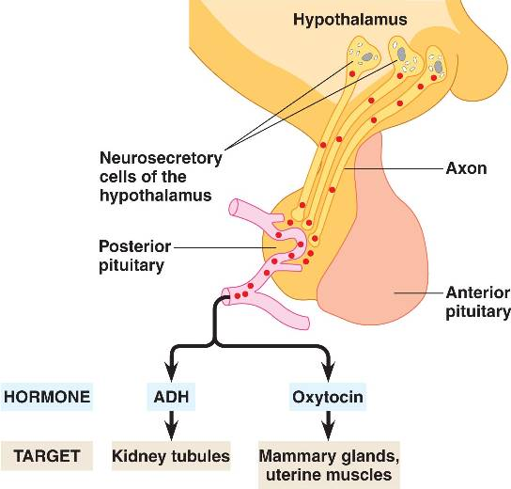
The Infundibulum and the Posterior Pituitary
Notes:
ADH is vasopressin

Slide 68
Why Regulate Water Retention?
Too much or too little blood volume
Salt concentration in blood is too high or too low

Slide 69
Vasopressin
What chemical type? | Peptide | 9 Amino acids
Where is it made? | Posterior Pituitary
What causes its release? | Hypothalamic osmoreceptors (PVN/SFO) and Mechanoreceptors (Carotid artery) | Increased osmotic pressure or reduced plasma volume
What are its receptors? | AVPR1-3 | GPCR (Gs)
What tissues does it affect? | Kidney (Collecting Ducts) | Water Reuptake (AQP2 trafficking)
 | Vascular System | Vasoconstriction
 | Anterior Pituitary | ACTH Release
How does it get turned off? | Normalization of volume/osmolality and AVPR receptor desensitization (arrestins)

Slide 70
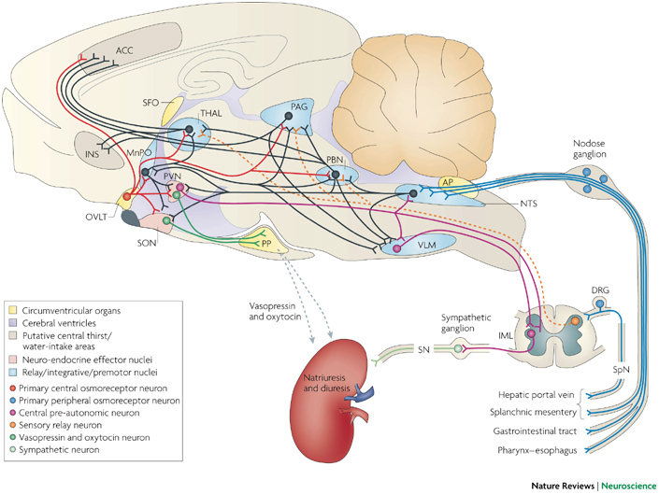
Vasopressin Release

Slide 71
Volume, Osmolality and Vasopressin
Vasopressin is released due to decreased blood volume or increased salt concentration
Decreased blood volume is detected by mechanoreceptors at the carotid sinus
Increased salt concentration is detected by osmoreceptors in the SFO and hypothalamus
In either case, the hormone dilutes the blood by retaining water.

Slide 72
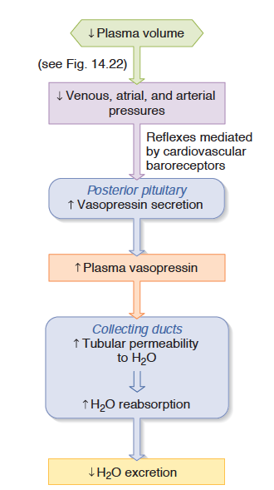
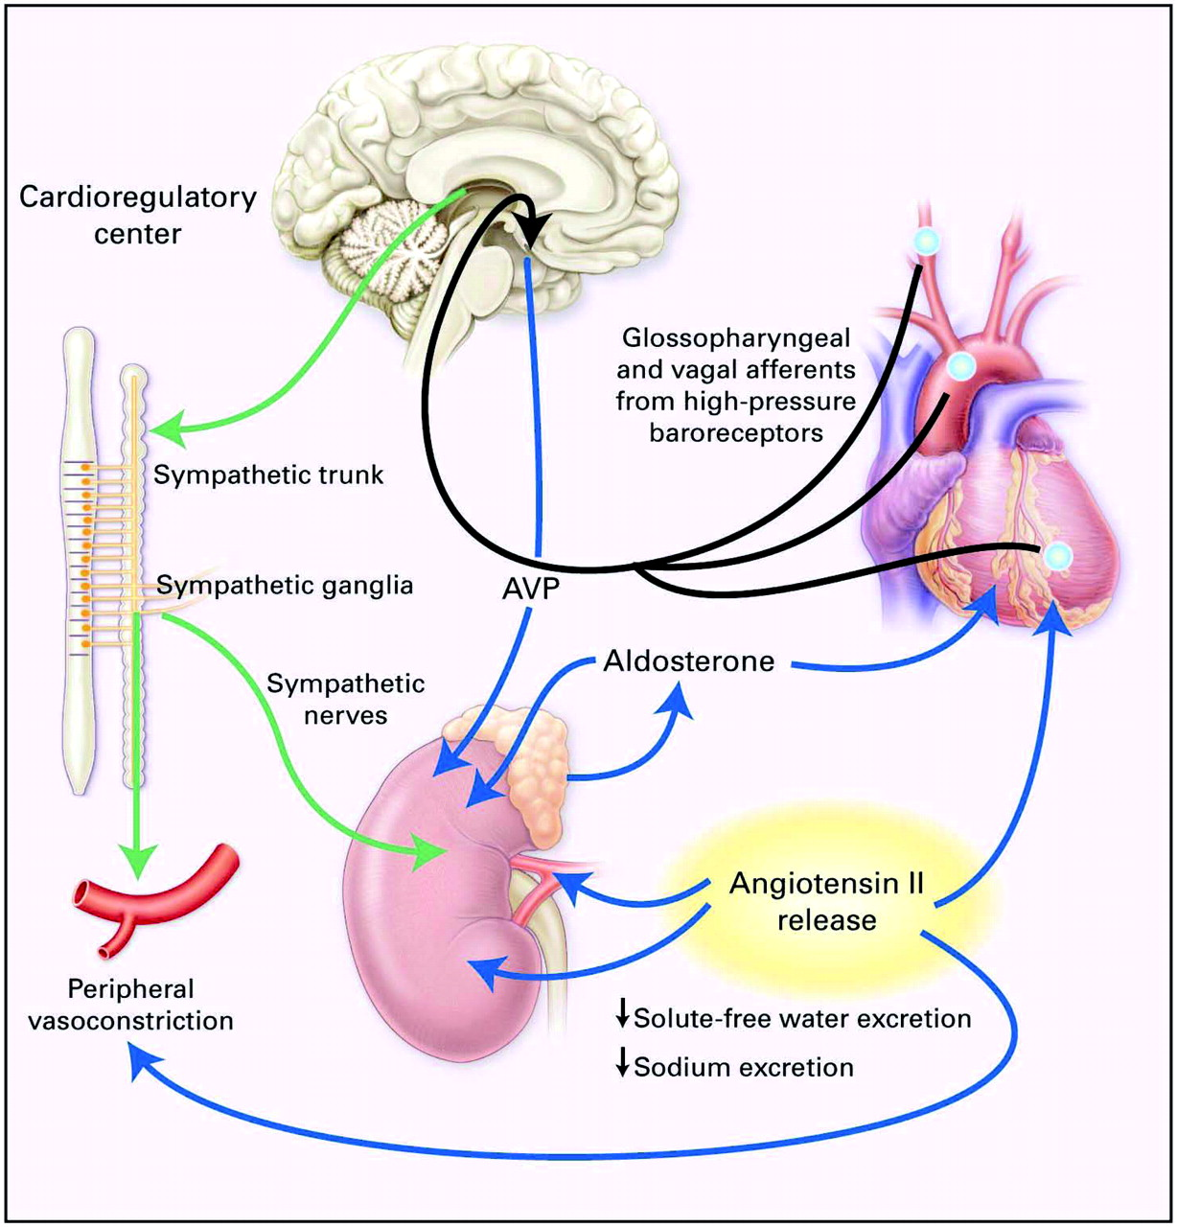
Baroreceptor Regulation of Vasopressin Release

Slide 73
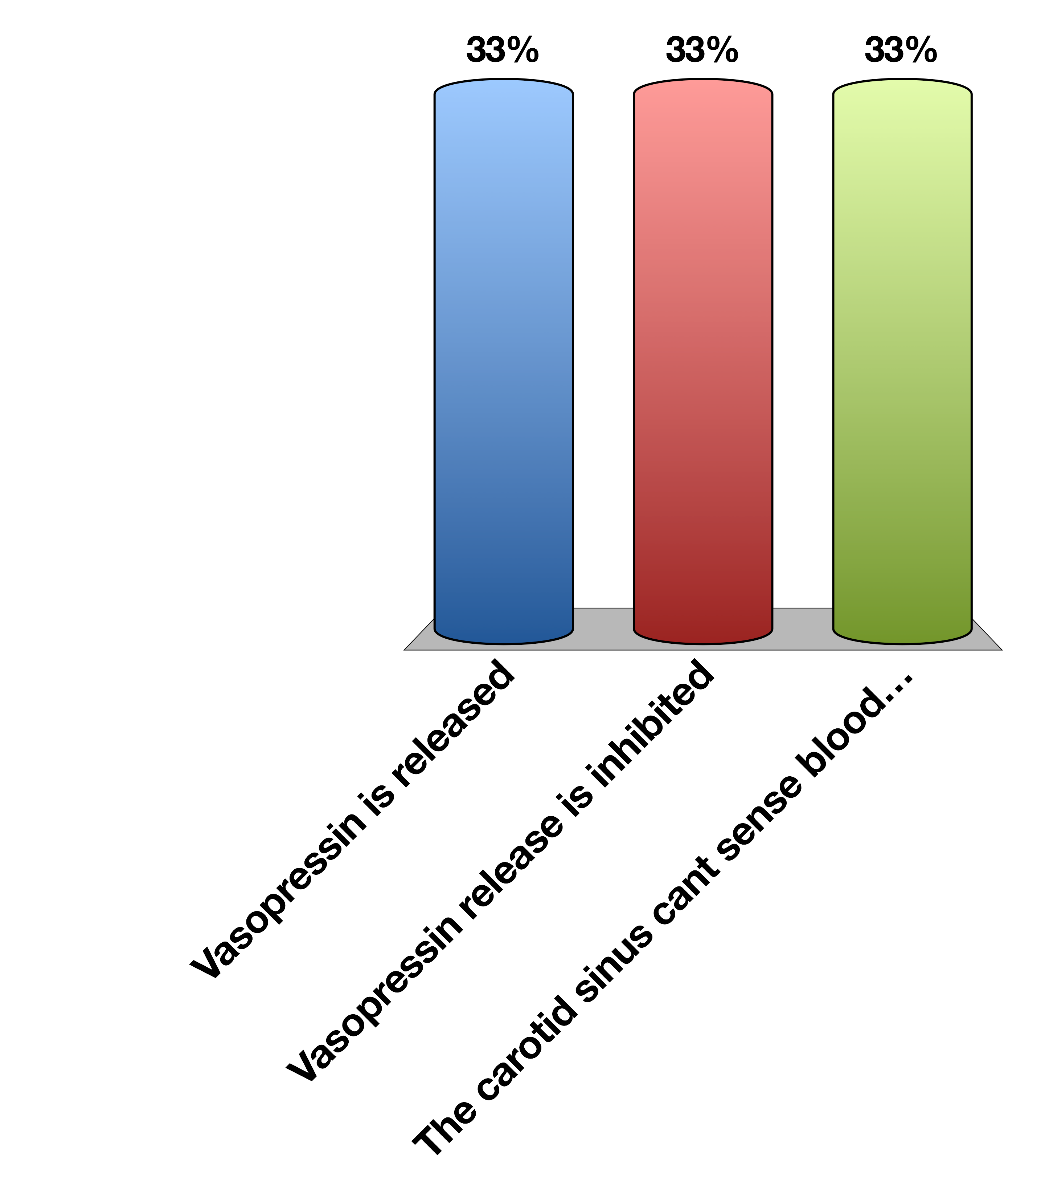
The carotid sinus senses increased blood volume due to drinking too much water…
Vasopressin is released
Vasopressin release is inhibited
The carotid sinus cant sense blood volume
More water is retained

Slide 74
If vasopressin release is activated by ethanol, this would cause increased urination
True
False
Notes:
False because more vasopressin would mean more water retention

Slide 75
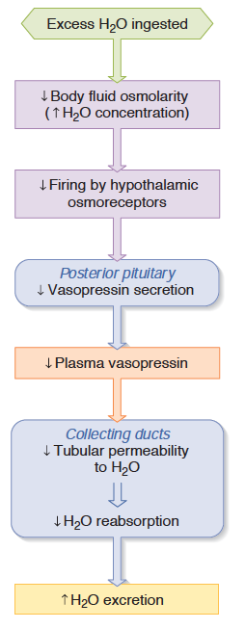
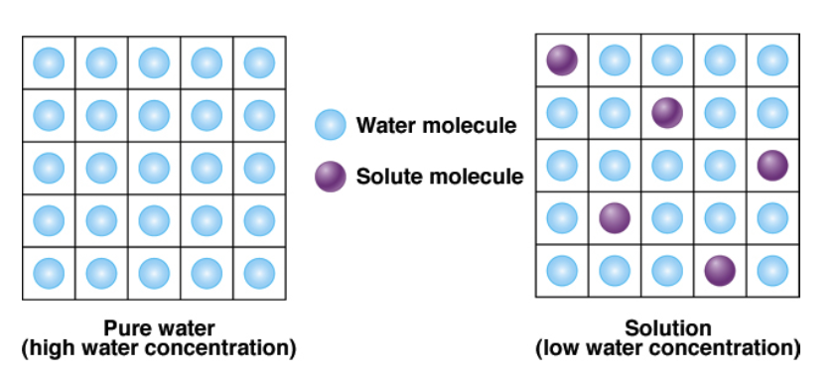
Osmoreceptor Regulation of Vasopressin Release

Slide 76
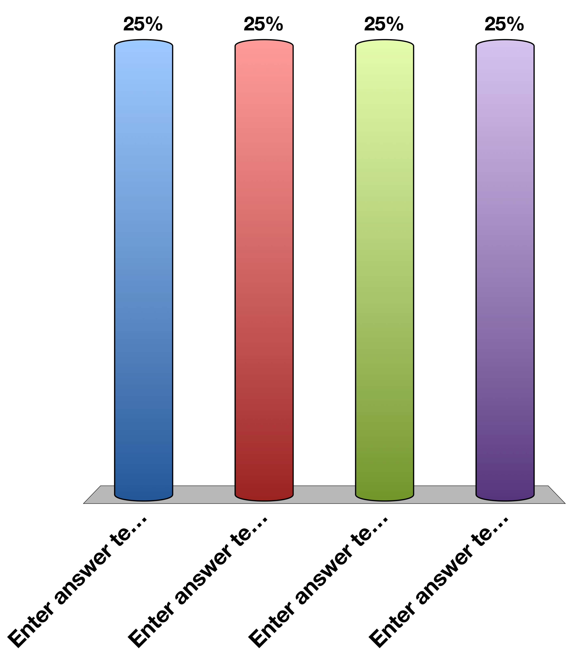
Aldosterone and vasopressin…
Both increase blood sodium concentration
Both decrease blood sodium concentration
Vasopressin reduces blood salt concentration, aldosterone increases it
Vasopressin increases blood sodium, aldosterone decreases it
Notes:
Aldosterone promotes salt reuptake, vasopressin promotes water reuptake

Slide 77
Aldosterone and vasopressin…
Both increase blood sodium concentration
Both decrease blood sodium concentration
Vasopressin reduces blood salt concentration, aldosterone increases it
Vasopressin increases blood sodium, aldosterone decreases it
Notes:
Aldosterone promotes salt reuptake, vasopressin promotes water reuptake

Slide 78
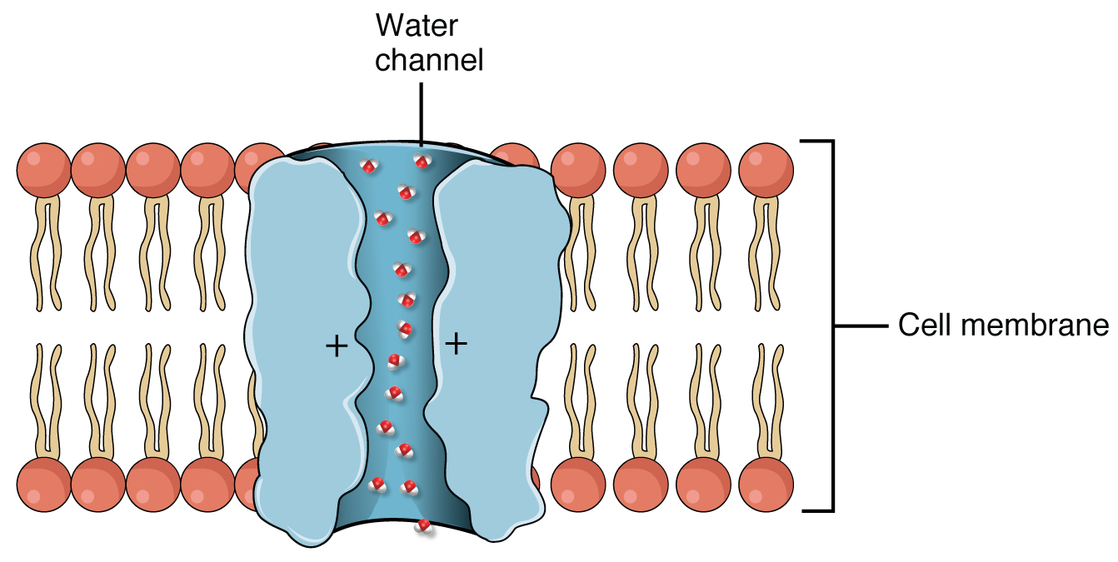
Vasopressin Regulates Aquaporin Trafficking

Slide 79
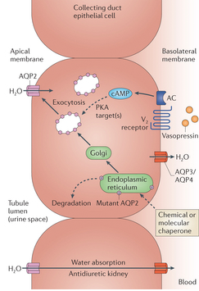
Effects of Vasopressin on the Kidney
Collecting
Tubules
Blood

Slide 80
Conditions with Altered Vasopressin Function
Lack of vasopressin signaling
Too much vasopressin signaling
Notes:
Not enough, can cause hypernatria, diabetes insipidus
This is because not enough water is pulled back in from the urine

Slide 81
Discuss with Folks Nearby
How could whiplash cause diabetes insipidus?
HINT: Relates to damage/severing of infundibulum
Notes:
Severed pituitary stalk -> low vasopressin -> low water reabsorbtion -> diabetes insipidus

Slide 82
Oxytocin Summary
What chemical type | Peptide
Where is it made? | Posterior Pituitary
What causes its release? | Synaptic activation in Hypothalamus (PVN, mechanism unclear)
What are its receptors? | OXTR
What tissues does it affect? | Uterus | Contractions
 | Mammary Glands | Let-Down Reflex (Lactation)
 | Neural | Positive Social Interactions
How does it get turned off? | Delivery (reduced input)

Slide 83
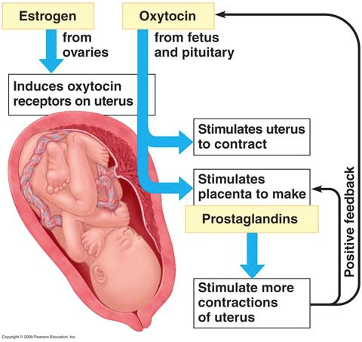
Oxytocin During Delivery
Notes:
Mention as there are cotnractions, that induces more oxytocin release.
This is a positive feedback loop

Slide 84
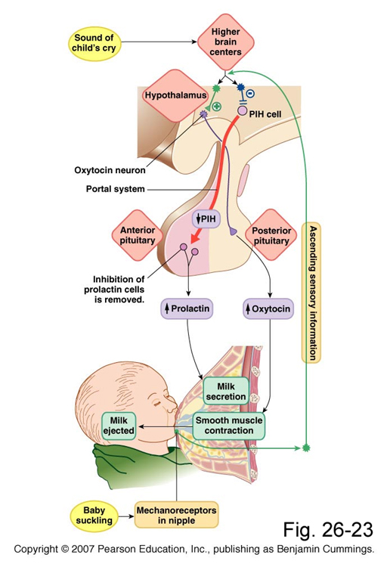
Oxytocin During Lactation

Slide 85
Learning Objectives
Recall anatomical, biochemical, and functional evidence showing intimate relationships between hypothalamus and pituitary.
Describe how hormones are sensed by the neurons of the hypothalamus, and the role that the blood brain barrier and transport mechanisms play.
Recall how the central nervous system can integrate with the hypothalamus and modify both hormonal secretions and executive function.
Describe the differences in how hypothalamic signals are passed to the posterior and anterior pituitary glands.
List the known hypothalamic hormones which cause release (and release-inhibition) of anterior pituitary hormones, including their acronymns.
Name two major posterior pituitary hormones, their chemical category, and succinctly describe their secretory mechanism.
Describe cellular actions of vasopressin in terms of site of actions, receptors, and cellular signals.
Discuss briefly aquaporin water channels and relation to vasopressin.
Predict what the changes are expected in urine volume and osmolality and in ECF volume when vasopressin synthesis or secretion is severely impaired. Predict what will happen to water intake. Explain why there can be transient diabetes insipidus following a whiplash injury, and the rationale for therapy during this time.
Describe the control of vasopressin release.
Describe the function of oxytocin with respect to delivery and lactation.

Slide 86
Your Future
Endocrine Control Systems
Neuroendocrinology and the Posterior Pituitary
Endocrine Control of Growth
Adrenals and Stress Hormones
Hypothalamus and Endocrine Control of Appetite
Pancreatic Hormones and Metabolic Control
Thyroid Hormones (KP)
Calcium Homeostasis (MF)
Reproductive Hormones (HP)

Slide 87
The End

